Slide 1
Economic Valuation of Moriah Harbour Cay, Exuma, Bahamas
Methodology Test Cases

Slide 2
Background
Moriah Harbour Cay established 2002
Protects beaches, sand dunes, mangroves, sea grass beds, bird nesting areas, bonefish nesting
Situated between Great and Little Exuma
Spans 13, 440 acres
Suggested protected area larger
Utilized by bonefishermen, tour guides, snorkelers, beach-goers, etc.
Private homes found in location
MHC not a no-take zone
Surrounded by two proposed marine parks
No commercial fishing done (no spearfishing, trapping, or netting)

Slide 3
Economic Valuation
What?
A means to estimate the value of environmental resources among Caribbean countries (Dominican Republic, Haiti, Jamaica, Bahamas)
How?
Different methodologies exist
Total economic value = direct-use value + indirect-use value + non-use value
Direct – Earnings dependent on tourism and fisheries resources
Indirect – biological support, physical protection by various entities
Non-Use – option/existence, general knowledge that a resource will still be in place for the next generation, guestimation
Why?
Consider Conservation vs. Development…
Development quantified in economic terms; Conservation traditionally qualified in qualitative or scientific terms.
Economic Valuation provides us with a means to present environmental values in the same way development projects are presented.
Notes:
What is Economic Valuation?
A means to estimate the value generated by a particular ecosystem service towards the local economy.
How is it calculated?
Different methodologies use different approaches. As you will see here, one is GIS based (Value Transfer), the other strictly financial based.
What Purpose does it serve?
Provides us a means to incorporate environmental considerations into legal, financial and policy considerations.

Slide 4
The Methodologies
Methodology | Source
Value Transfer - Spatial Distribution of Ecosystem Service Values | Troy/Wilson
Coral Reef Valuation - Tourism & Recreation | World Resources Institute
Coral Reef Valuation – Fisheries | World Resources Institute

Slide 5
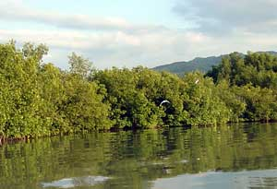
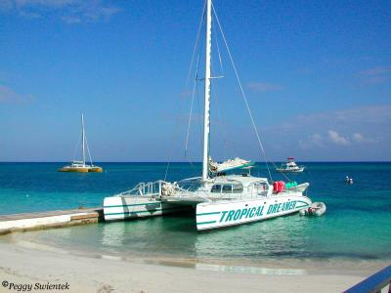
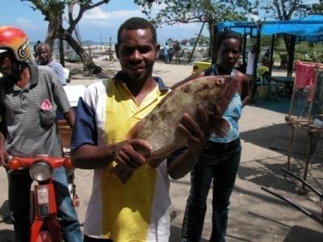
Value Transfer
Adapted from: Austin Troy, Matthew A. Wilson
ECOLOGICAL ECONOMICS
Mapping ecosystem services: Practical Challenges and opportunities in linking GIS & Value Transfer

Slide 6
Theory
Values of different habitats are determined (coral reefs, mangroves, etc.)
Habitat areas are calculated using GIS
Estimated acreage x $$ value
Total Value
Habitat Type 1 Value
Habitat Type 3 Value
Habitat Type 4 Value
Habitat Type 2 Value

Slide 7
Overview
Process
GIS used to outline ecological resource/terrain types
Multiply resource area against multiplier ($ contribution/hectare/yr)
Weaknesses
Value Multipliers not universally applicable
MHC not on GoogleEarth map as yet (still in draft)
Development of new multipliers is an extensive undertaking
Multipliers not accurate; estimation of area

Slide 8
Value Transfer - Results
Ecosystem Type | $/ha/yr | Total Hectares | Total Contribution
Beach | $45,500 | 100.0 | $4,550,000
Beach Near Dwelling | $72,155.72 | 100.0 | $7,215,572.00
Urban & Disturbed Beach (housing) | $0.00 | 100.0 | $0.00
Coppice | $0.00 | 150.0 | $0.00
Coral Reef (G.B.) | $448,381.52 | 200.0 | $689,676,304.00
Mangrove | $13,287.00 | 70.0 | $930,090.00
Rivers, Streams, Freshwater | $0.00 | 0.0 | $0.00
MORIAH HARBOUR CAY NATIONAL PARK - TOTAL ESV |  |  | $102,371,966.00
Notes:
Habitats for which we did not have multiplier coefficients: grass/shrubland and seagrass beds. Both habitats exist in notable amounts and should also be incorporated in future valuations.

Slide 9
Distribution of Values
Notes:
Despite abundance of Mangroves (25% of the total calculated area of Coral Reefs), they represent only a fraction of the $ value of corals, due to the lower multiplier value.

Slide 10
Summary
Pros
User friendly
Low dependence on external/hard to locate data sources
Produces both graphic and numeric results
Cons
Multipliers (values) developed for NE United States
Not all local habitats represented
Does not provide exact numbers for hectares outside of the NE United States
Challenging to develop local values, which are critical to the accuracy and validity of the tool
Time consuming – lack of proper software in local depts.
Notes:
Discussion
Higher values for beaches?
Urban & Disturbed Beaches - Buffer zone value? Currently set at $0/hectare/yr

Slide 11
Possible Value Transfer
“Future” Tax | $/ha/yr (per year) | Total Hectares | Total Contribution
Mooring-commer. Mooring-private | $75.oo per year $15.00 per year |  | $75.00 $15.00
Boat Rental | $35.00 per trip |  | $35.00
Boat Registration | $20.00 per boat |  | $20.00
Boat Entry/License | $300.00 per trip |  | $300.00
 |  | TOTAL | $445.00

Slide 12
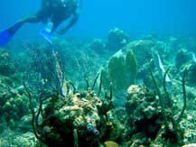
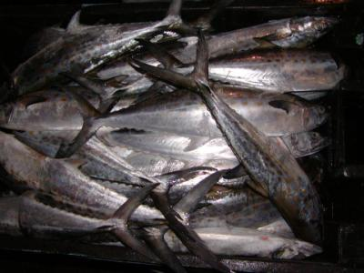
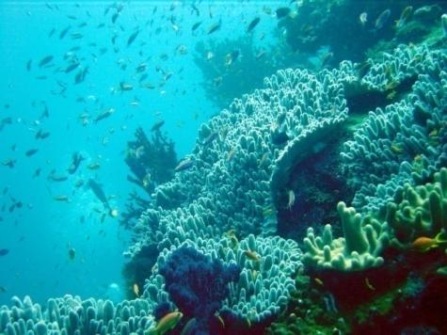
World Resources Institute
Coral Reef Valuation

Slide 13
Theory
Fisheries
Tourism & Recreation
Shoreline Protection
Economic Valuation of Coral Reefs
Notes:
The World Resources Institute has developed a comprehensive methodology for calculating the economic value of Coral Reefs against three primary indices: Tourism and Recreation; Fisheries production; and Shoreline Protection.
As suggested by the title: “Economic Valuation of Coral Reefs”, this methodology focuses primarily on the role played by Coral Reefs. In contrast to the previous methodology, which focused on a range of habitats within the coastal zone, WRI drills down into sectoral benefits of the Coral Reefs.
A second substantial difference between the two approaches is the level of formal data required. This will become more apparent as we move forward through the WRI methodology.

Slide 14
Overview
Process
Review spreadsheets & manuals
Analyze Data requirements
Collect Data
Enter data, review results, modify, review, modify…
Calculate scenarios
Strengths
Highly detailed results
Triangulates ESV of coral reefs
Tools – MS Excel
Weaknesses
Data - Heavily dependent upon external data sources
Aspects not yet developed (Coastal Protection)
Dependencies/Assumptions (built into formulas)
Missing data proves WRI format “inadequate”

Slide 15
Coral Reef Valuation - Tourism
Category (Calculated for peak season May – Sept) | Value
Accommodation | $30, 542.82
2. Diving | $30,940.00
3. Snorkeling and Boating | $28,600.00
4. Marine Parks | $0
5. Other Direct Expenditures - Total Value | $0
TOTAL DIRECT ECONOMIC IMPACTS | $90,082.82
6. Total Indirect (secondary) Impacts (from multipliers) | $4,343,242.40
TOTAL DIRECT AND INDIRECT IMPACTS | $4,433,324.82
7. Un-captured Value
Local Use of Coralline Beaches | $
Local Use from reef recreation | $9,350
TOTAL IMPACT OF REEF-RELATED TOURISM AND RECREATION | $4,442,674.82
Notes:
Numbers consolidated from Tourism Valuation spreadshee/sub-categories eliminated to preserve space.

Slide 16
Anomalies – National Park Revenue
Moriah Harbour National Park Category (Zero Rated) – WHY?
Visitor Fees
Entrance – No single entry point
Diving – No fees in place
Snorkeling – No fees in place
Concessions – No concessions in operation
(diving and snorkeling fees paid to dive shops)
Vessel Fees
No vessel fees
No mooring fees
Other Fees
Fishing Permits (Marine Resources Division)
Fishing vessels recorded by Department of Marine Resources are 20 ft and larger
Notes:
Marine Parks – Demonstrate $0 as none of the conventional methods of cost recovery (included within the tool) are implemented by the Park. Important to note that the Marine Park Trust (Park Manager since inception) has had to cover overhead expenses through project activities.
Notable inputs (for which there is no place to include within the tool) include intermittent Beach Fee subsidies remitted by the national body (National Environmental Protection Agency), approximately US$7,000 once every other, or third year; Management Fee (infrequent; two or three years since park inception, ave of US$50,000/yr), and; Interest payments from the National Park Trust Fund (again, infrequent and usually to the tune of JA$ 2- 3 million; US$25,000 - $35,000).

Slide 17
Anomalies – Undervaluation
Coastal Protection
Third valuation tool not yet developed
Would add critical third figure to overall Coral Reef Valuation figure
Multiplier
Total Indirect Impacts
Function did not work
A lot of guessing

Slide 18
Coral Reef Valuation - Fisheries
Category (entire Bahamas) | Value
1. Commercial Fishermen (data from 2005) | 345
1a. Fish Processing and Cleaning | $30 per bag
3. Value range of fish collected | $1.00 – 15.00 per fish
"commercial" in relation to fishing means the fishing for any fishery resource for the purpose of subsequent sale whether the person fishing for the same does so on a full-time basis or part-time basis;
http://laws.bahamas.gov.bs/statutes/statute_CHAPTER_244.html#Ch244s19
Notes:
There is no commercial fishery in Montego Bay. As such, total contribution has been calculated at $0.
WRI spreadsheet requires entries so as not to produce division by zero results. To overcome obstacle, ones (1) were entered in each line item and then physically manipulated in exported spreadsheet.

Slide 19
CHAPTER 244 FISHERIES RESOURCES (JURISDICTION AND CONSERVATION)
19. (1) The Minister may make regulations for any or all of the following purposes
(a) for the conservation and management of the fishery resources of the exclusive fishery zone which are consistent with this Act and with the following standards-
(i) conservation and management measures shall prevent overfishing while achieving the optimum yield from each fishery resource;
(ii) conservation and management measures shall be based upon the best available scientific information;
(iii) to the extent practicable, an individual stock of fish shall be managed as a unit throughout its range, and interrelated stocks of fish shall be managed as a unit or in close co-ordination;
(iv) conservation and management measures, where practicable shall promote efficiency in the utilisation of fishery resources; except that no such measure shall have economic allocation as its sole purpose;
(v) conservation and management measures shall take into account and allow for variations among, and contingencies in, fisheries, fishery resources and catches;
(vi) conservation and management measures shall where practicable minimise costs and unnecessary duplication;

Slide 20
CHAPTER 244 FISHERIES RESOURCES (JURISDICTION AND CONSERVATION)
(b) regulating the taking of any species or kind of fishery resource (whether by reference to size or weight or otherwise) absolutely or during such period or periods as may be specified anywhere within the exclusive fishery zone;
(c) limiting the quantity of any fishery resource which may be taken by any person;
(d) prohibiting the taking of any fishery resource by any specified method within the exclusive fishery zone;
21. (1) No person shall, otherwise than as prescribed or under the authority of and in accordance with the terms of a licence granted to that person for the purpose by the Minister- Restriction on export and import of fishery resources.
(a) export any fishery resource from The Bahamas;
(b) import into The Bahamas any fishery resource specified by the Minister by notice published in the Gazette as requiring such a licence.
http://laws.bahamas.gov.bs/statutes/statute_CHAPTER_244.html#Ch244s19

Slide 21
WRI Valuation - Totals
Jamaica
Tourism: US$119,315,604
Fisheries: US$1,128,748
Coastal Protection: (N/A)
$120,444,352.00
Bahamas
Tourism: US$90,082.82
Fisheries: US$102,371,966.00
Coastal Protection: (N/A)__________
$102,462,048.82

Slide 22
Results Comparison (JA Results)
Methodology | Source | Value
Tourism | Spatial | N/A
 | WRI | US $119 million
 | WB | US $210 – 630 million
Fisheries | Spatial | N/A
 | WRI | $1,128,748
 | WB | US ($1.66m) – $7.49 million
Coastal Protection | Spatial | N/A
 | WRI | N/A
 | WB | US $65 million
Value Transfer | Troy/Wilson | US$47 million
Notes:
Important:
World Bank Methodology serves as our benchmark – 4 year study benefited from NRM specialists, economists and social scientists.
WRI and WB methodologies specifically calculated economic value of Coral Reefs, whereas Value Transfer methodology calculated all habitats within the marine park.
Discrepancy between contributions most readily explained as follows:
WRI Methodology:
Excluded cruise ship passengers
Third Tool (Coastal Protection) – Not yet available
Value Transfer:
Figure is low, most likely due to multipliers/coefficients being incorrect. Area calculations had a high degree of accuracy based on 2001 Sat image and should therefore be much closer to, if not higher than World Bank results.

Slide 23
Discussion
Preferred Methodology?
Data Requirements
Sources
Relevance
Date
Considerations for broader use
Stakeholders
More Results
Better Database

Slide 24
What can be done?
Work
Time
Dedication
Discipline

Slide 25
Thank you!

