Slide 1
MISSION TO SUPPORT THE FIGHT AGAINST CORRUPTION AND IMPUNITY IN HONDURAS
MACCIH-OAS 2017 Achievements and 2018 Work Plan
July 12th, 2018

Slide 2
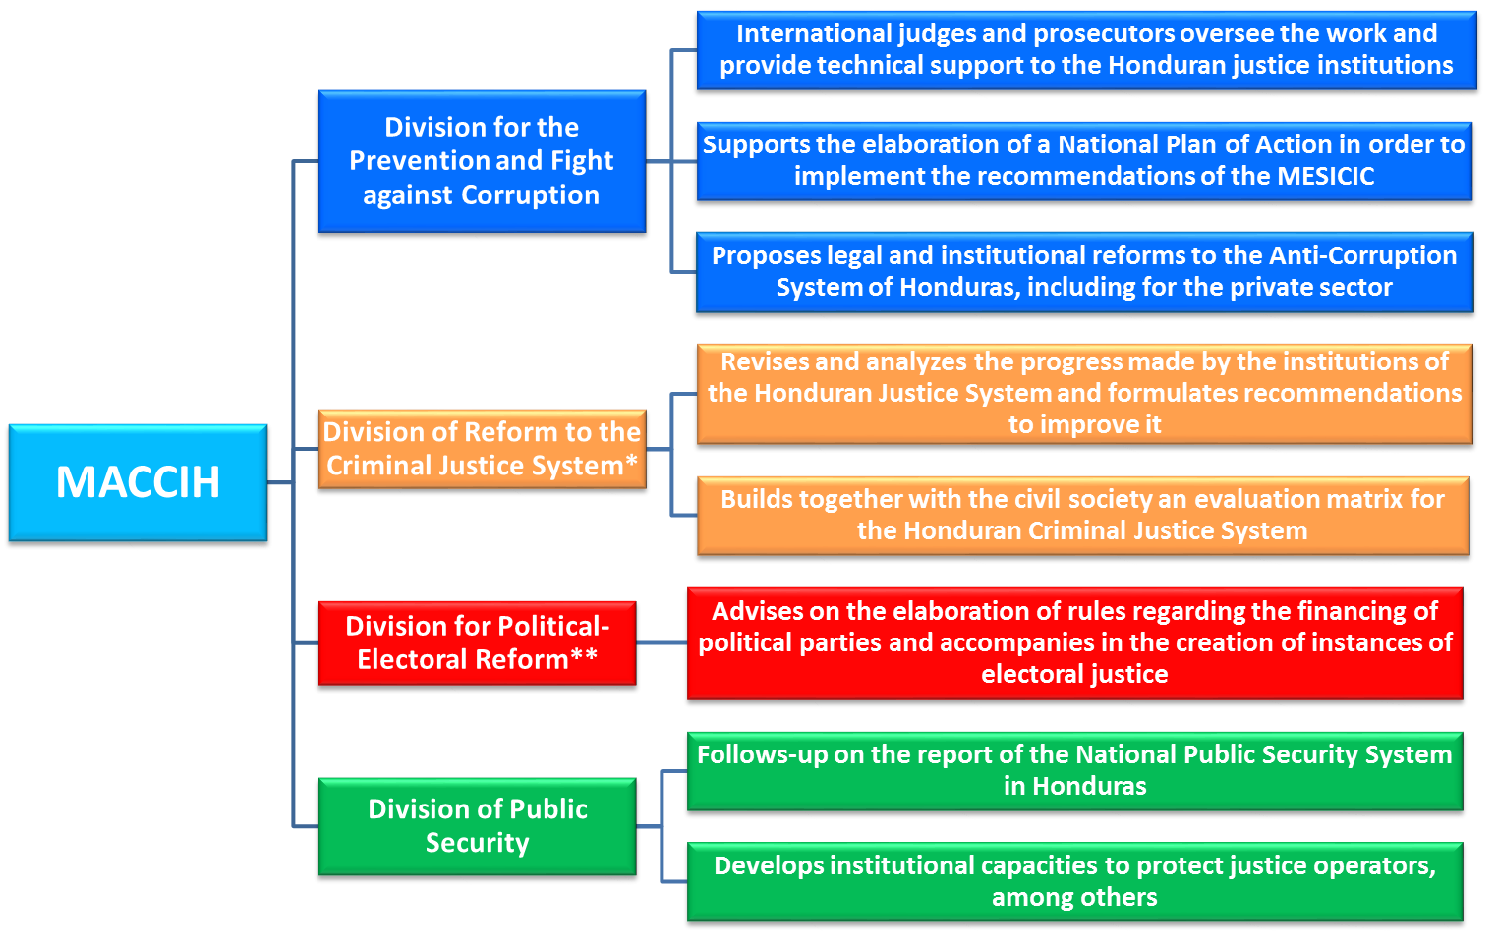
Lines of Action

Slide 3
Summary of Results
Division for Preventing and Combating Corruption
Strengthen investigation, prosecution and dismantling of corruption networks Improve the capacity of the Honduran institutions to investigate and prosecute corruption networks • active collaboration with the Honduran institutions commissioned with investigating and combating corruption and impunity
ACHIEVEMENTS OBTAINED | 2018 WORK PLAN
National Anti-corruption System Consolidated the new Honduran National Anti-corruption System with the collaboration of the MACCIH-OAS: National Anti-corruption Jurisdiction; and Special Prosecution Unit to Fight Corruption-Related Impunity (UFECIC). Consolidation of the methodology of Integrated Investigation and Criminal Prosecution Teams MACCIH-OAS/UFECIC. Creation of 14 Integrated Teams that investigate cases of high-level corruption through the UFECIC. The MACCIH-OAS and the UFECIC reached milestones in the prosecution of anticorruption in Honduras: Adjudicated unprecedented cases, such as: “Red de Diputados”, “Caja Chica de la Dama”, “Pacto de Impunidad”, and “Pandora”. MACCIH-OAS’ collaboration on high-level cases: IHSS (most severe conviction for acts of corruption), Los Cachiros, Agua Zarca (Berta Cáceres), Judicial Council, among others. Technical assistance from the MACCIH-OAS in other preeminent cases, such as: “Teodoro Bonilla” (first conviction for the crime of influence peddling). Eliminated reparatory agreements in anti-corruption cases (conciliation). | Expand capacity with the opening of the MACCIH-OAS Annex Office in San Pedro Sula and increase personnel in the areas of investigation and prosecution, as per previous agreement with the AG. Develop a certified system for receiving complaints for the UFECIC. Develop a database for the Division for Preventing and Combating Corruption of the MACCIH-OAS. Foster a transparent election of the Honduran Attorney General. Constitute Integrated Teams to investigate corruption cases with other Honduran institutions. Prepare additional protocols to continue strengthening the work of the Office of the Attorney General.

Slide 4
Summary of Results
Division for Preventing and Combating Corruption
Strengthen investigation, prosecution and dismantling of corruption networks Improve the capacity of the Honduran institutions to investigate and prosecute corruption networks • active collaboration with the Honduran institutions commissioned with investigating and combating corruption and impunity
ACHIEVEMENTS OBTAINED |  | 2018 WORK PLAN
Legislative Reforms and Regulations | The MACCIH-OAS presented legislative anti-corruption initiatives, among others: Reforming current regulations regarding the prosecution of senior public officials Law on International Judicial Cooperation and Extradition Plea Bargain Bill (Effective Collaboration) Classification of Public Documents of Security and National Defense Bill Recommendations for the Social Security Bill Recommendations for the new Criminal Code Additionally, worked on guidelines and recommendations for a mechanism for business regulation and certification of "anti-corruption compliance" in Honduras and negotiations were facilitated with the main Honduran business associations for their implementation. | Follow up on initiatives presented in 2017-2018 that have not yet been approved, such as: Reforming current regulations regarding the prosecution of senior public officials Law on International Judicial Cooperation and Extradition Plea Bargain Bill Classification of Public Documents of Security and National Defense Bill Recommendations to the Social Security Bill Present new legislative initiatives that contribute to the institutional strengthening of Honduras in anticorruption matters (Illicit Enrichment Bill, among others). Propose initiatives for the prevention of corruption, such as streamlining of procedures, among others. Continue to train officials of the Criminal Justice System and members of those institutions with which MACCIH-OAS has cooperation agreements. Prepare a National Action Plan to implement the recommendations of MESICIC. Continue to implement institutional strengthening programs with academia, civil society, national and international counterparts.
Institutional Strengthening | Technical assistance and institutional training to members of the UFEFIC, members of the National Anti-corruption Jurisdiction, Office of the Inspector General (PGR), High Court of Auditors (TSC), Institute of Access to Public Information (IAIP), National Anti-corruption Council (CNA), among others.

Slide 5
Summary of Results
Division of Criminal Justice System Reform and the Observatory of the Criminal Justice System
Promote the application of reforms and recommendations to strengthen the criminal justice system Improve the application of reforms in order to strengthen the criminal justice system • Strengthen the institutional capacity to reform the criminal justice system • strengthen the civil society capacity to monitor the reforms
ACHIEVEMENTS OBTAINED |  | 2018 WORK PLAN
Justice Studies Center of the Americas (JSCA) | Prepared the methodological framework for the diagnostic study of the Criminal Justice System. JSCA experts conducted several visits to Honduras to collect qualitative and quantitative information. Analyzed and systematized the information collected. | Process quantitative and qualitative data on specific topics used in the study Prepare the Final Report on the study of the Honduran Criminal Justice System, including recommendations for its enhancement. Develop and disseminate the results of the study to the general public.
Observatory for the Criminal Justice System | Collected quantitative and qualitative data to populate the validated indicators in the Permanent Evaluation Matrix of the Honduran Criminal Justice System. Created the website (www.observatoriohonduras) for the diffusion of activities, achievements, and information about the MACCIH-OAS. Established a Temporary Committee to begin the process of defining the Observatory structure. Prepared a study on “The Access to Justice by Population in Vulnerable Situations”. Conducted dialogue forums with the participation of civil society on the work and initiatives proposed by the MACCIH-OAS. | Develop and implement the Observatory’s decentralization plan. Continue promoting spaces for dialogue with civil society and academia, through seminars, workshops, and forums. Accompany the process of defining the organic structure of the Observatory. Carry out a general assembly Make a general report on the functioning of the Criminal Justice System, including data for 2017. Continue monitoring, analyzing, and observing in situ, the criminal justice system, and sharing information through the website. Inform civil society and academic organizations about the work of the MACCIH-OAS.

Slide 6
Summary of Results
Division of Political-Electoral Reform
Increase the transparency and accountability of the financing of Honduran political parties Train political parties and civil society on the norms and mechanisms of political financing • Support the state to ensure transparency and accountability of political financing
ACHIEVEMENTS OBTAINED | 2018 WORK PLAN
Honduras held the first general elections implementing the Law of Financing, Transparency, and Oversight of Political Parties and Candidates: “Ley de Política Limpia” with a compliance level of 87% Advised on the creation and implementation (selection of members and training) of the Financing, Transparency, and Oversight Unit, responsible for the implementation of the Law. Organized training sessions to exchange experiences with other countries on campaign financing. Established a process of continuous dialogue with political parties, candidates, and civil society organizations on the financing of the policy. Established a cooperation agreement to carry out technology transfers from the National Electoral Institute of Mexico (INE). Presented a study on the implementation of the Law of Financing, Transparency and Oversight with recommendations. Carried out a performance evaluation of the Financing, Transparency and Oversight Unit. | During 2017 and the first quarter of 2018, the objectives proposed in the MACCIH-OAS Constitution Agreement were fulfilled in political-electoral matters, therefore the Mission is terminating the work of this division for next year.

Slide 7
Summary of Results
Division of Public Security
Improve the application of reforms and recommendations adopted to strengthen the public security system Improve the institutional implementation of reforms to strengthen public security systems • strengthen the institutional capacity on citizen security, protecting human rights defenders, journalists, and justice officials
ACHIEVEMENTS OBTAINED | 2018 WORK PLAN
Proposed legislative initiatives and reforms The MACCIH-OAS presented legislative proposals and recommendations for the strengthening of the National Police and the protection of the justice officials. Proposed regulations to establish a Special Protection System for justice officials, within the framework of the Law on the Protection of Human Rights Defenders, Journalists, Social Communicators, and Justice Officials. Proposed recommendations to the Organic Law of the Police and Police Career Law: Supported the incorporation of the concept of Community Policing Supported the inclusion of a gender perspective in the police career and the inclusion of vulnerable populations (such as LGBTI communities). Provided support to the police vetting and restructuring process Participated in the process of identification and cleansing of police officers investigated for corruption, among others. | Implementation of the recommendations formulated in the evaluation of the National Public Security System (SNSC) Review the evaluation diagnoses and recommendations made to the SNSC. Develop the mechanism for implementation and monitoring of recommendations for continuous reporting.
 | Initiatives and reforms for strengthening the National Police Provide technical assistance for the revision of normative disciplinary frameworks. Promote mechanisms to strengthen the National Police’s approach to gender and Human Rights.
 | Penitentiary Certification System Promote mechanisms to strengthen the focus on Human Rights and gender in prisons.
 | System for the protection of Human Rights defenders, journalists, social communicators, and justice officials Install the Protection Unit to justice officials in the Judiciary and Office of the Attorney General. Provide support in the establishment of an early warning system.
 | Create a mechanism for Witness Protection to strengthen the existing regulations.

