Slide 1
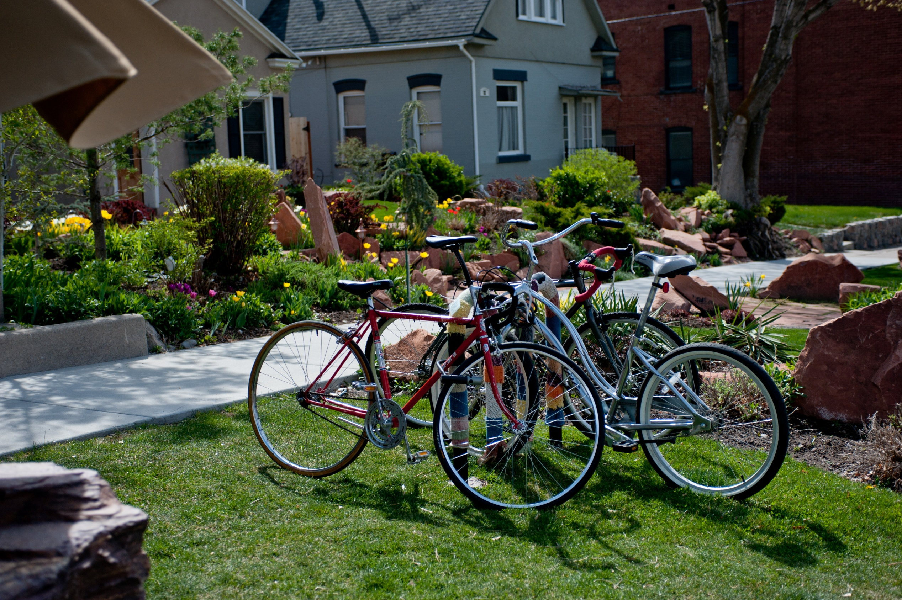
Sustainable Transportation & Air Quality

Slide 2
Salt Lake City
Notes:
Salt Lake City – capitol of Utah and a beautiful place to live. Mid-size city surrounded by the Wasatch Mountains, world class skiing and outdoor opportunities.
Most days are clear and bright, however for roughly 20-30 days a year our valley looks like this…

Slide 3
Salt Lake City
Notes:
During our winter inversion season, our geography works against us and traps air pollutants.
Problem faced by many major cities around the world, including Los Angeles and Beijing.
We have a very visible and unpleasant problem. And it effects the health of our residents.
Children are kept inside for recess, and bikers where face masks.
Historical problem, but our community has reached a tipping point and are demanding action from their leaders.

Slide 4
www.ClearTheAirChallenge.org
Notes:
In 2009, Salt Lake City was one of the first Utah organizations to proactively address the major contributor to our air pollution – motor vehicles.
We know that well over 50% of air pollution comes from tailpipes, which means everyone has a role to play in reducing our pollution.
The Clear the Air Challenge was created by Salt Lake City and our partners to challenge our residents to “Drive Less, Drive Smarter” to reduce vehicle trips & miles.

Slide 5
Notes:
SmartTrips is another such program that takes a neighborhood-base approach to encourage behavior change through alternative transportation.
Every year we target a new neighborhood in the city and provide customized resources, events and amenities.
It’s a popular model with real results first piloted in Oregon.

Slide 6
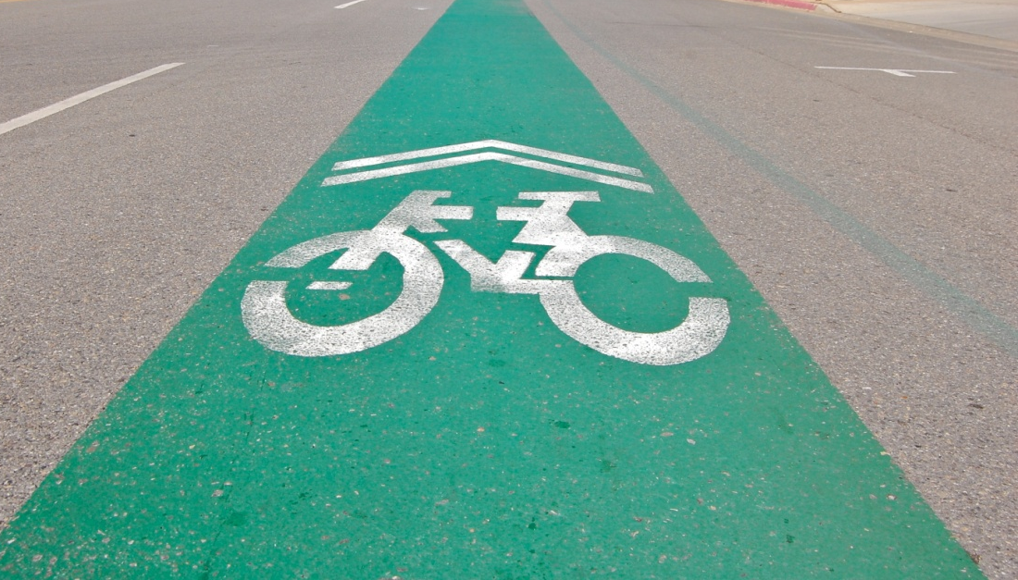
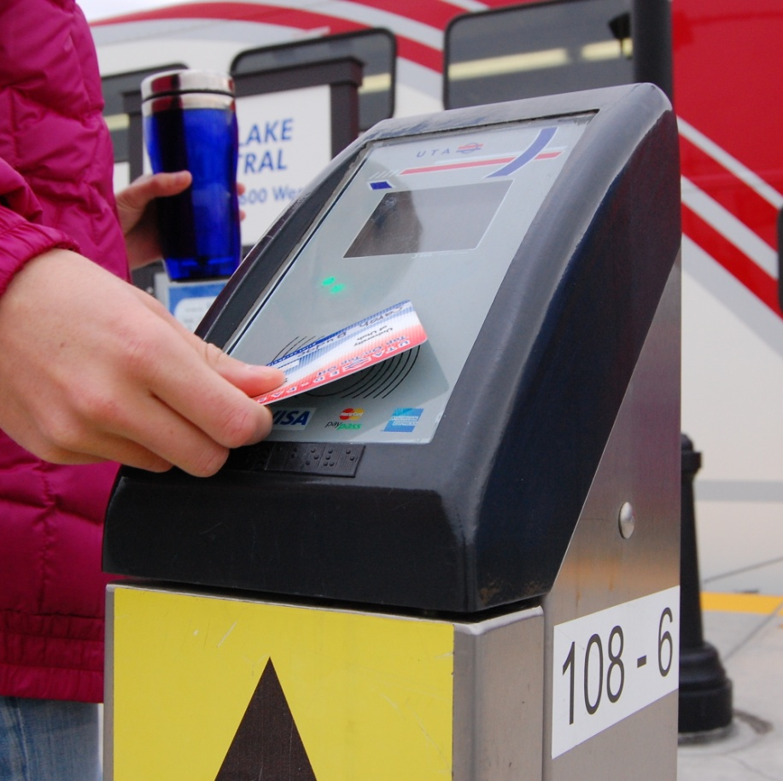
Barriers & Challenges
Notes:
BARRIERS:
“It’s just me”
Comfort level
Ease & accessibility
CHALLENGES:
Encouraging concrete action
Fostering sustained change –
SOLUTION:
Community based social marketing.

Slide 7
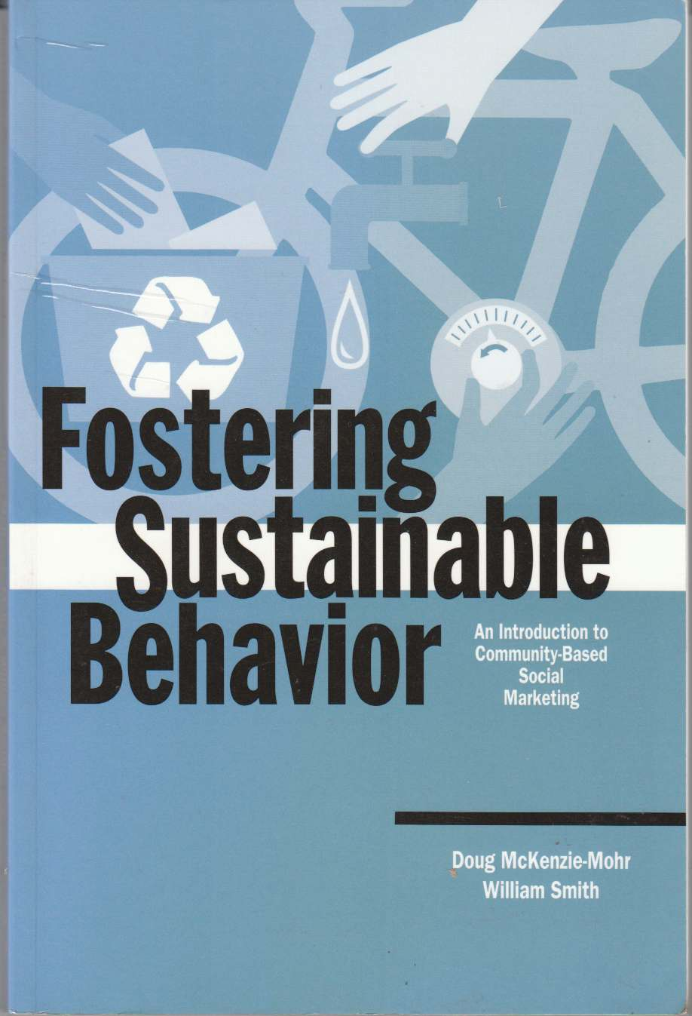
Behavior Change
Community-Based
Social Marketing
cbsm.com

Slide 8
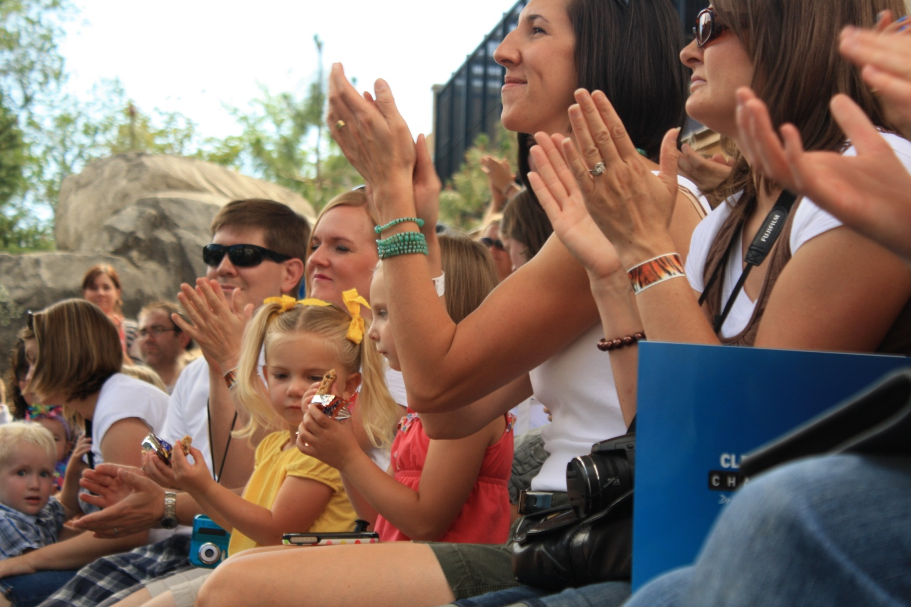
Audience & Message
Hogle Zoo Blogger Event, July 2012
Notes:
One of our key lessons learned and areas of success was to identify our audience and tailor our messages to resonate with them.
The picture here was taken at our kick-off event for the 2012 Clear the Air Challenge.
That year we used survey data to identify Utah moms as an audience concerned about air quality for family health and with flexibility and the potential to change their behaviors.
The “mommy blogging” community became a conduit to reach this audience, so we teamed up with the popular blog Today’s Mama, reached out to over 100 local bloggers, and hosted a kick-off event at Hogle Zoo for them and their families with games, giveaways, treats and a media event.

Slide 9
Annual Impact
5,653 MtCO₂e greenhouse gas emissions
=1,838 tonnes of waste sent to the landfill
=2,118,149 liters
of gasoline consumed
= 100 tonnes
= 100,000 liters
Notes:
Annual impact of our Climate Showcase Communities program – 5,653 metric tons of greenhouse gas emissions.
Equal to over 1800 tons of waste sent to the landfill and over 2.1 million liters of gasoline consumed.
EPA-verified impact of our Climate Showcase Communities program, which includes all of the efforts that fall under the “Sustainable Transportation for a Sustainable Future” umbrella. Factors in direct data from our programs, observation data, UTA ridership numbers and comparative traffic counts. The impacts are also ongoing as our efforts continue.

Slide 10
Annual Impact
$542,452 = Project Cost
$5,400,230 saved in total vehicle cost
= $100,000
Notes:
This graphic displays the annual savings in total vehicle costs that resulted from our Climate Showcase Communities program, which is over 5.4 million dollars. To give you an idea of dollars invested versus dollars saved, the dollars in red represent our project cost.

Slide 11
San Jose Twinning Transition (IMAGE)
Lessons from San Jose
Notes:
Transition to lessons learned from the twinning process with San Jose, Costa Rica

Slide 12
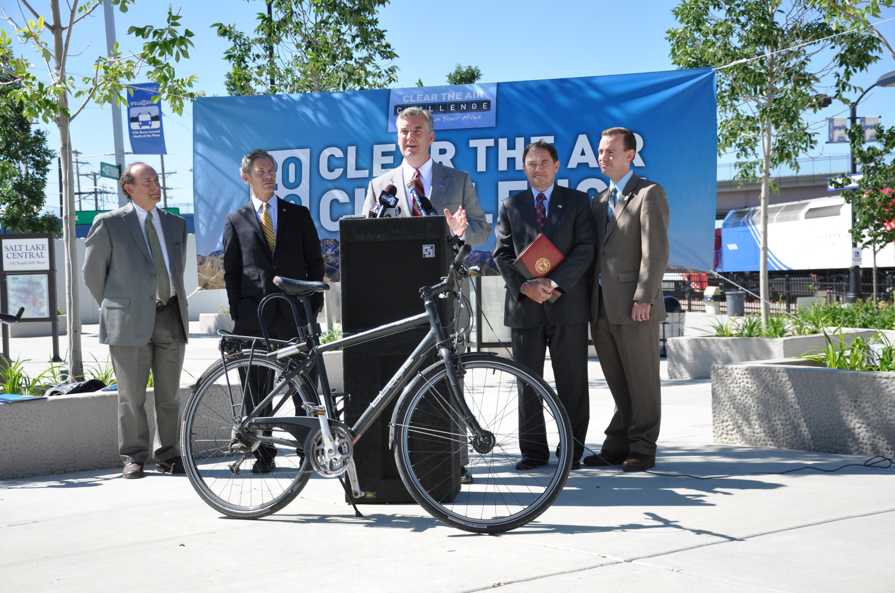
Community Gardening
Lesson 1: Partners
Notes:
Both cities found success through strong partnerships with other organizations in our cities.
Air Quality Partners Team – government, non-profit, business & faith organizations
Work together to design programs, combined resources to spread the word & ensure success

Slide 13
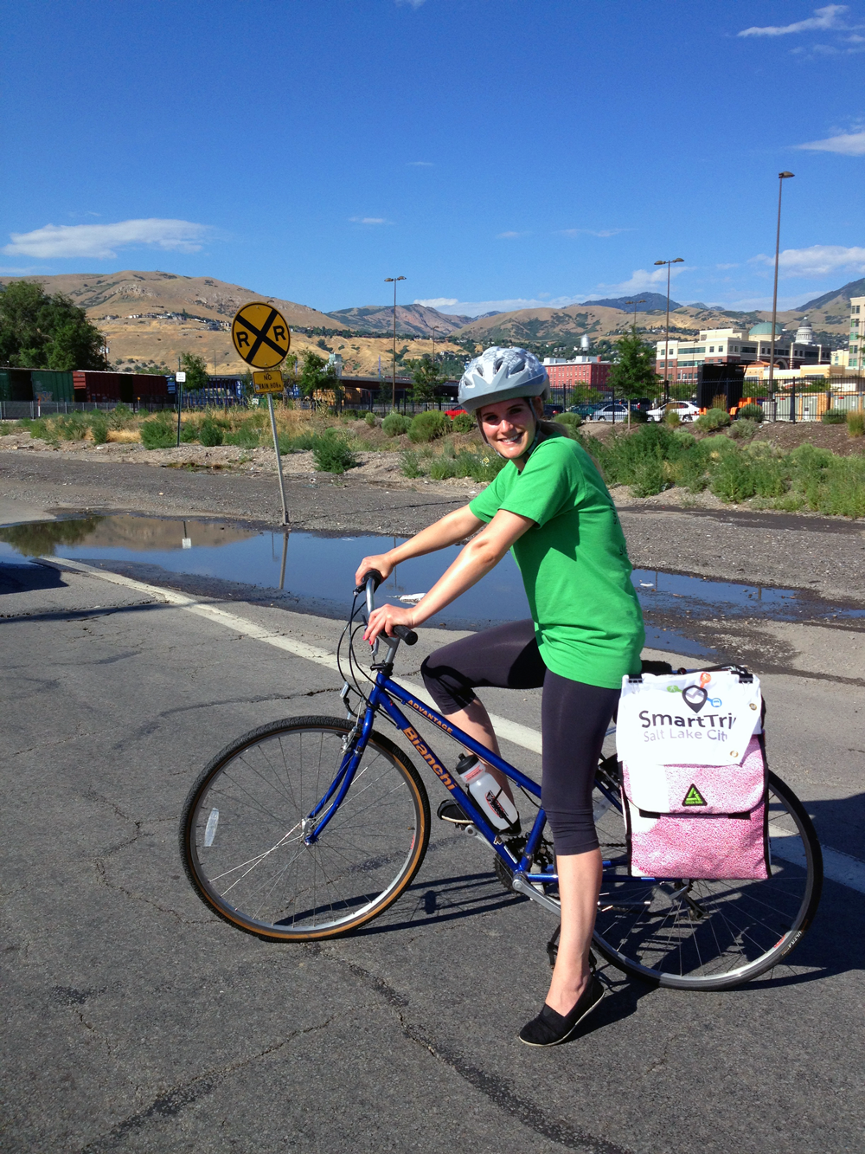
Lesson 2: Health
Personal
Family
Community
Notes:
Our two cities have incorporated health messages into our programs, but in very different ways. We can learn from each other’s experience.
Salt Lake City has emphasized a health message related to the effects of particulate air pollution. This has been a huge community motivator because it taps into our values of family and personal health & strength.
San Jose has emphasized the health benefits of an alternative commute – especially by bike. Strong partnership with Health Ministry.
This is a growth opportunity for Salt Lake City. Have worked with the local health department, but there is potential to bring in their health promotion staff to enhance our SmartTrips program.

Slide 14
Lesson 3: The Last Mile
Notes:
We both struggle with the challenge of the “last mile” – that final mile from the end of your ride on public transit to your final destination.
Look to bikes as a potential solution – San Jose has very clear messaging about the benefits of a multi-modal trip by bike AND public transit.
Salt Lake City has some growth potential here to expand our communications efforts to emphasize a multi-modal commute (bikes are welcome on bus & train in SLC).

Slide 15
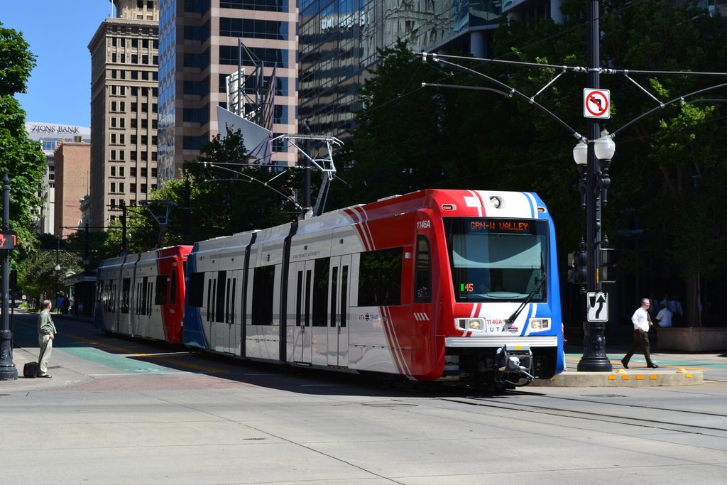
Lesson 4: Culture
Notes:
We each face unique cultural challenges.
Salt Lake City – like any other American city – was built to make travel by car quick and convenient. Our transit agency has made important strides to expand infrastructure, which is half the battle, but our connections to cars runs deep. Our programs have made important strides, but we have more work to do.
One of the most striking differences I noticed in our conversations with San Jose is that vehicle travel takes more time in their central business district. In Salt Lake City, the opposite is the case. Transit takes more time.
This is a problem that our transit agency and the city continue to work on – which can be looked at two ways. Increasing barriers to quick car travel and decreasing service frequency and routes for transit.
Possible point? We also have had to be thoughtful about the language we use when working with partners outside of Salt Lake City. Instead of focusing on our differences related to global climate change and our the local impacts we are already feeling, we focused on what brought us together – the air quality. This was a successful strategy for us, as we have been able to work with partners across a wide variety of groups and interests.

Slide 16
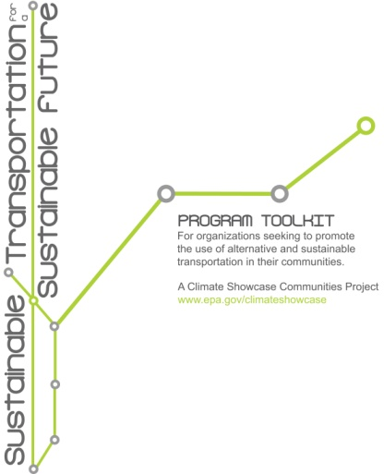
Sustainable Transport Toolkit
Download at
www.SLCgreen.com
Notes:
One of our most significant outcomes from our Climate Showcase Communities grant was the creation of the Sustainable Transportation for the Sustainable Future toolkit.
Guide through the program creation process, with advice on how to craft your project, bring partners on board, target your audience, build effective messages, get the word out and evaluation.
In our talks with San Jose, they have a lot of interest in this resource and we are excited to continue working with them as, in their own words, they “Costarican-ize it”

Slide 17
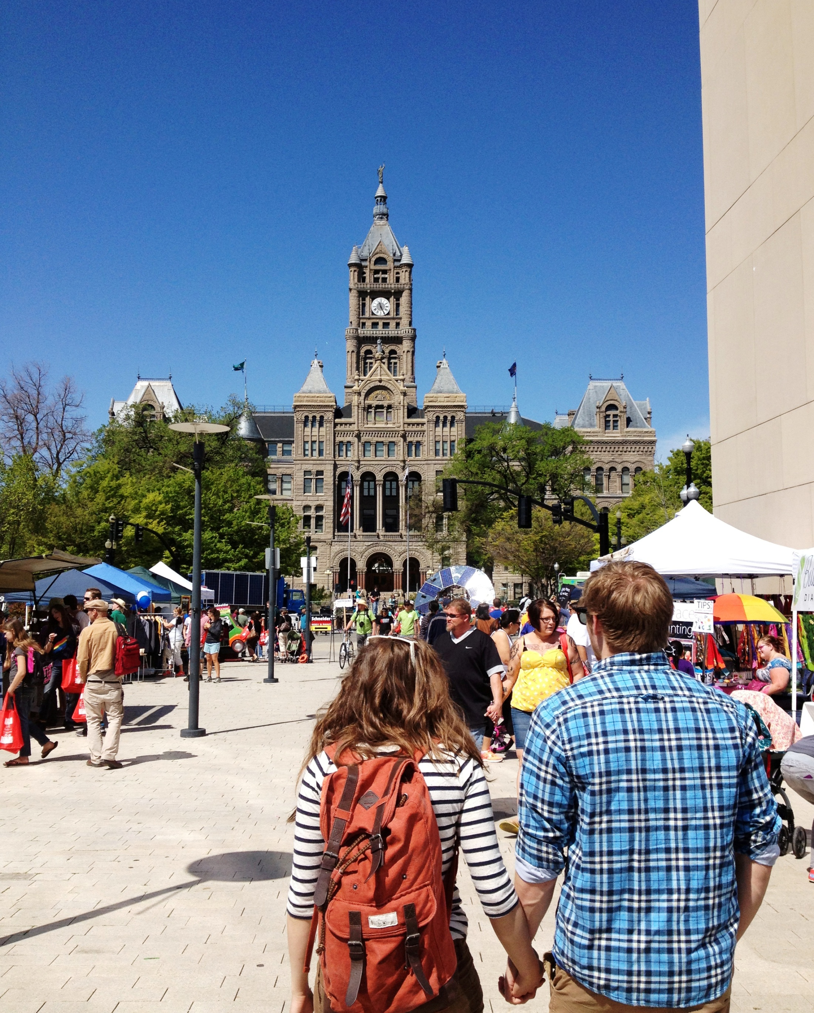
Kate Lilja Lohnes
Communications Manager
Sustainability, Salt Lake City
kate.lohnes@slcgov.com
Notes:
Closing thoughts…

Slide 18
More Information
SLCgreen.com
fb.com/saltlakecitygreen
instagram.com/slcgreen
@slcgreen
slcgreen.wordpress.com
Notes:
Links to more information

Slide 19
Photo Credits
San Jose: Armando Maynez (Flickr)
Partners: Utah Transit Authority
TRAX in SLC: Garrett (CountyLemonade via Flickr)
All other images are the property of Salt Lake City.
Notes:
Photo credits (do not show during presentation)

