Slide 1
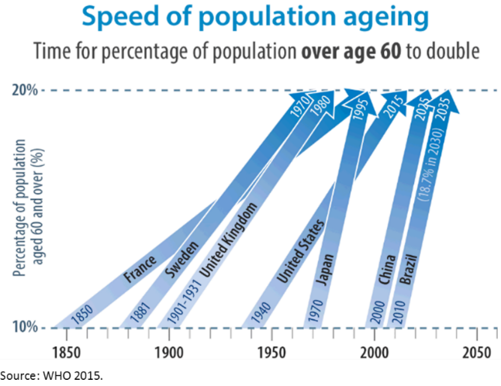
Rapid demographic change creates an imperative for countries to better harness their human capital.
Labor productivity in many LAC countries has languished for years during which growth was supported by favorable ‘tailwinds’.
Countries now faces powerful demographic ‘headwinds’ on growth.
Populations in many LICs and MICs are ‘ageing’ at an unprecedented pace.
The demographic ‘window of opportunity’ to productively engage young people is closing.
  In Brazil, the ‘working age’ population will peak in 5 years.

Slide 2
Education systems are falling short of expectations: Poor performance, repetition and dropouts.
Drop out rates
Source: WBG Brazil Expenditure Review, Education chapter

Slide 3
Younger people are more likely to withdraw from the labor force, particularly the lower skilled
Source: BR Skills and Jobs 2, using PNAD surveys

Slide 4
Policy makers have to look beyond reform of labor market regulation for solutions.
Correlation between de-jure ‘rigidity and youth unemployment is weak
More ‘active’ policies and programs have shown favorable results
Intermediation, counseling and coaching are more cost effective than skills training.

