Slide 1
New Business Models in the Accommodation Industry
Benchmarking of rules and regulations in the short-term rental market

Slide 2
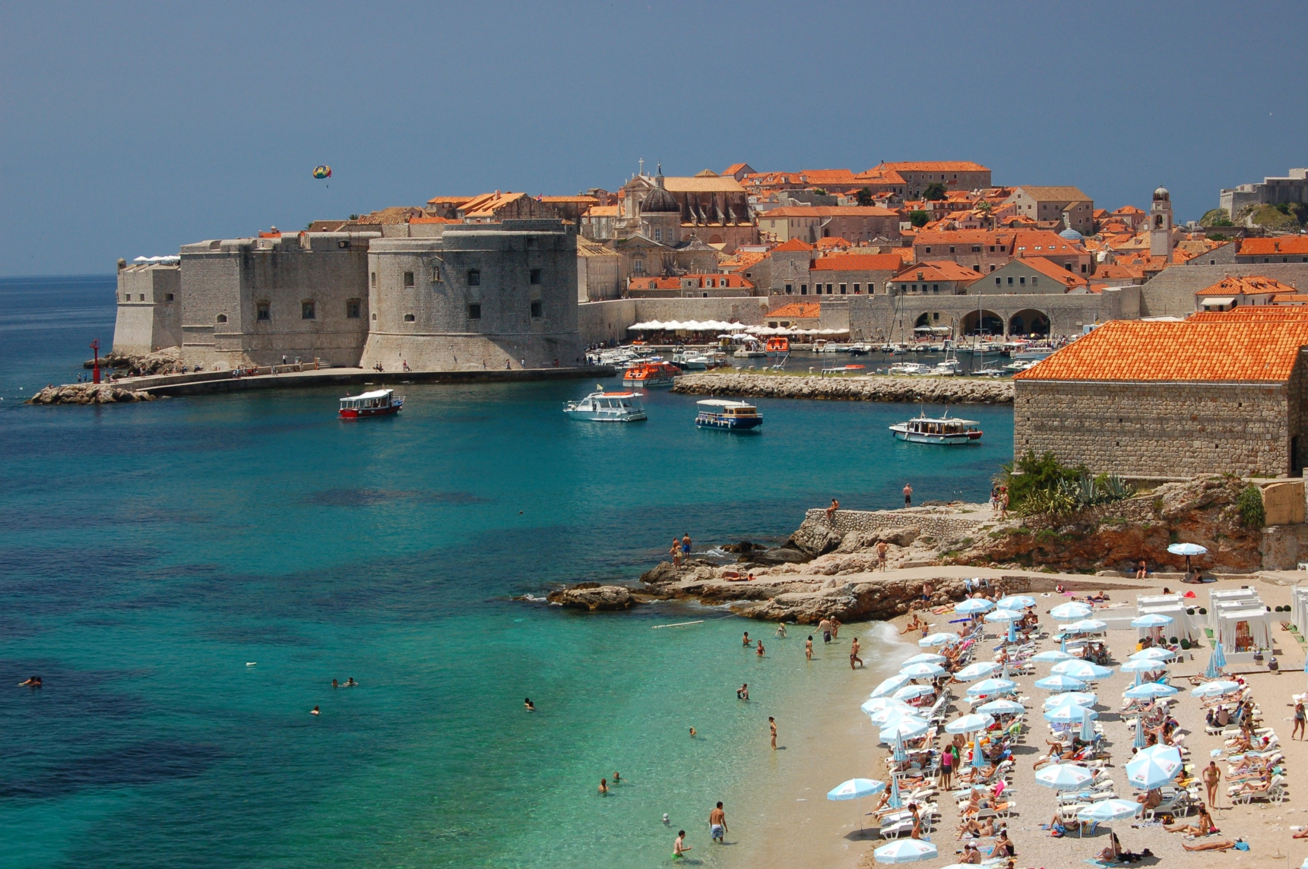
A first comprehensive benchmark of rules and regulations on short-term home rentals around the world

Slide 3
case studies
3 areas of action
14 typologies of measures

Slide 4
Areas of action:
Fair competition
2. Consumer protection
3. Planning & sustainability

Slide 5
Methodology
Survey to Member States
Desk research
Validation of case studies

Slide 6
Case Studies - New Business Models in the Accommodation Industry
Benchmarking of rules and regulations in the short-term rental market
Europe | Austria (Vienna) Belgium (Flanders) Bosnia and Herzegovina Czech Republic France (Paris) Germany Greece Italy (Veneto region) The Netherlands (Amsterdam) Portugal Slovakia Spain (Catalonia, Barcelona) United Kingdom (England, London)
Americas | Barbados Chile Costa Rica Mexico United States of America (NY State + NYC )
Asia Pacific | Japan Republic of Korea
Middle East | United Arab Emirates (Dubai)

Slide 7
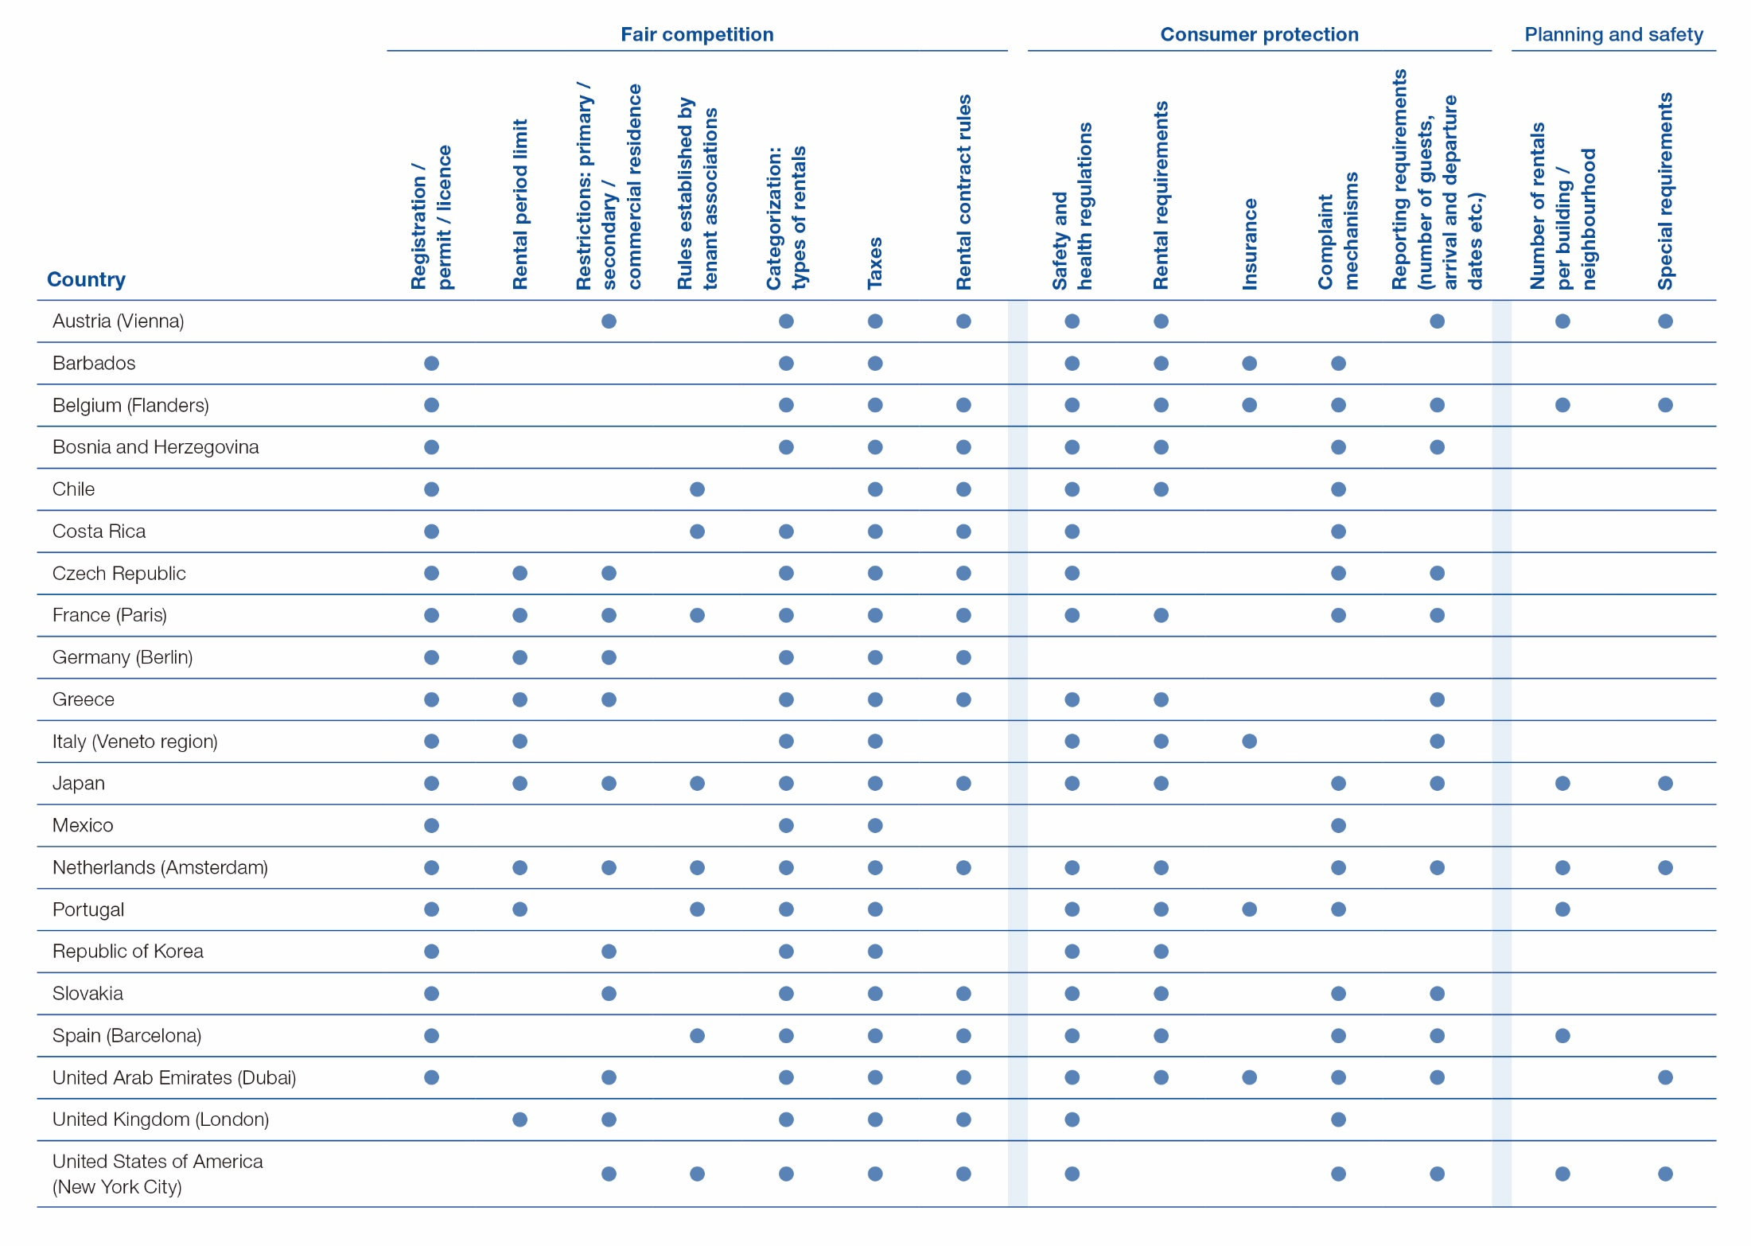
Source: New Business Models in the Accommodation Industry- Benchmarking of rules and regulations in the short-term rental market, UNWTO, 2019

Slide 8
Key areas
Taxation (95% of the cases): ensuring that taxes are collected and remitted to the authorities
Categorization of rentals (95%): e.g. renting part of the house, a private room or the entire house
Consumer protection (91%): requirements on health and safety are in place in almost all the cases (basic hygiene and safety standards as well as fire protection)

Slide 9
Key areas:
Permits and registration (81%): registration with the local authorities, obtaining a license, a registration number or a permit
Contract rules (76%): e.g. the written consent of the owner in case the tenant wants to sub-let the property as a short-term vacation rental is frequently required
Complaint mechanisms (76%)
Rental requirements (71%): size, furnishing, ventilation, etc. of the property

Slide 10
New Business Models in the Accommodation Industry
https://www.e-unwto.org/doi/book/10.18111/9789284421084

Slide 11
Thank you
scarvao@unwto.org

