Slide 1
CARIBBEAN SMALL HOTELS October, 2015 Tegucigalpa, Honduras Presenter: Denise Aleong-Thomas

Slide 2
Background
Location: Southeast of North America, East of Central America and North of South America.
Main exports: petroleum, gas and oils; bananas, cocoas, sugar and rum; gold, corundum, aluminium oxide and hydroxide and iron ore products; fertilisers; Tourism.
Climate: Tropical with rainy and dry season.
Languages: Mother tongue is English. However, some islands also speak, Spanish, Dutch, Creole and French.
October, 2015 Tegucigalpa, Honduras Presenter: Denise Aleong-Thomas

Slide 3
Why Tourist come to the Caribbean?
To escape from their temperate countries and to enjoy the tropical climate.
To experience the culture, food, language.
It’s History & Heritage.
It is more cost effective to travel to the Caribbean in comparison to other parts of the World.
Stable political climate and democracy.
Explore business opportunties.
Leisure.
The warm and welcoming personalities of our People.
October, 2015 Tegucigalpa, Honduras Presenter: Denise Aleong-Thomas

Slide 4
Why Tourist come Caribbean Small Hotels?
Unique Memorable Experience
Value for Money within the Community.
Locally owned and operated.
Intimate, one-on-one interaction with the Owner/Operator.
Personalised service – “home away from home” effect.
Cost effective accommodation, thereby saving on vacation dollars to spend on other aspects of their visit on sight-seeing, entertainment and food.
October, 2015 Tegucigalpa, Honduras Presenter: Denise Aleong-Thomas

Slide 5
Caribbean Small Hotels - PAST
Disorganised and scattered group of small properties with little or no Industry recognition nor benefits.
Minimum standards and quality accommodation.
No incentives provided.
Little Government support or assistance.
In some instances, were affiliated with the Hotels Association, at which, its needs and goals were not achieved.
October, 2015 Tegucigalpa, Honduras Presenter: Denise Aleong-Thomas

Slide 6
Caribbean Small Hotels - Present
Antigua & Barbuda initiated Antigua Stay Inc. in July 2012 and presently has a membership of 17 properties with room stock of approximately 200 rooms.
Advocacy and representation to Government Agencies such as the Utilities for paymnet plans.
Concesssions on imports for property upgrade.
October, 2015 Tegucigalpa, Honduras Presenter: Denise Aleong-Thomas

Slide 7
Caribbean Small Hotels - Present
Hidden Gems of St. Lucia started in September, 2014 and currently has 14 member properties with room stock of approximately 200 rooms.
Still in its embroyonic stage, now finalising the process of legally registering the brand.
Continues to get support from the St. Lucia Tourist Board and the St. Lucia Hotel & Tourism Association in promoting its Brand.
Established relationships with North American Tour Operators, Travel Agents and Online Travel Agencies.
October, 2015 Tegucigalpa, Honduras Presenter: Denise Aleong-Thomas

Slide 8
Caribbean Small Hotels - Present
Tobago Unique Bed & Breakfast & Self-catering Association (TUBBSCA) was rebranded in 2013.
Membership of 19 properties with a room stock of 90.
Its focus is on showcasing the unique and authentic vacation experience of Tobago with its new branding of “Live Tobago – Love Tobago”
Types of accommodation include:
(a) Homely Village Abodes
(b) Tropical Garden Villas
(c) Ocean View Apartments
October, 2015 Tegucigalpa, Honduras Presenter: Denise Aleong-Thomas

Slide 9
Caribbean Small Hotels - Present
Small Tourism Accommodation Owners of Trinidad and Tobago was established in 2008 with 10 properties with a total room stock of 46 rooms.
Currently has a membership of 21 properties with room stock of 106 rooms and growing.
Recognised as the Organisation representing small hotels with 1 to 20 rooms, Locally, Regionally and Internationally.
Signed a Suppliers Agreement with the Association of Canadian Travel Agencies (ACTA) in 2011 as a Membership Discount Supplier.
October, 2015 Tegucigalpa, Honduras Presenter: Denise Aleong-Thomas

Slide 10
Caribbean Small Hotels - Present
S.T.A.O.T.T. Training & Development:
(a) Introduction to Going Green
(b) Conflict Resolution
(c) Record Keeping
(d) Customer Relations Management
(e) First Aid
(f) Marketing Techniques for Small Hotels
(g)Effective Housekeeping Skills
(h)Excellence in Hospitality Services
(i) Breakfast Cookery
(j) Caribbean Tourism Organisation’s (C.T.O.)
Hospitality Assured Program Certification
October, 2015 Tegucigalpa, Honduras Presenter: Denise Aleong-Thomas

Slide 11
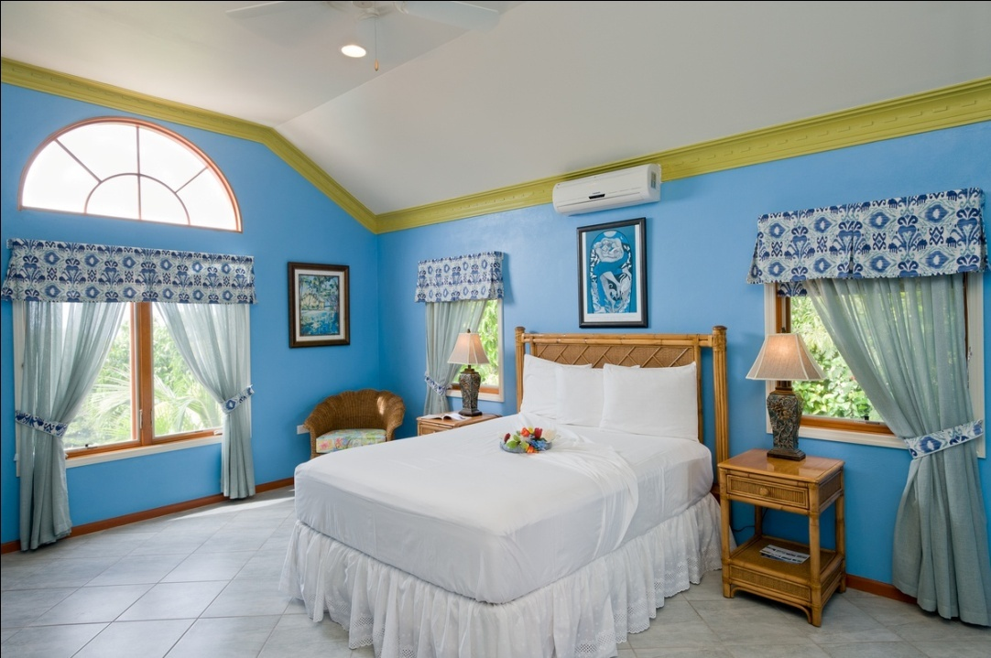
Caribbean Small Hotels - Present
October, 2015 Tegucigalpa, Honduras Presenter: Denise Aleong-Thomas

Slide 12
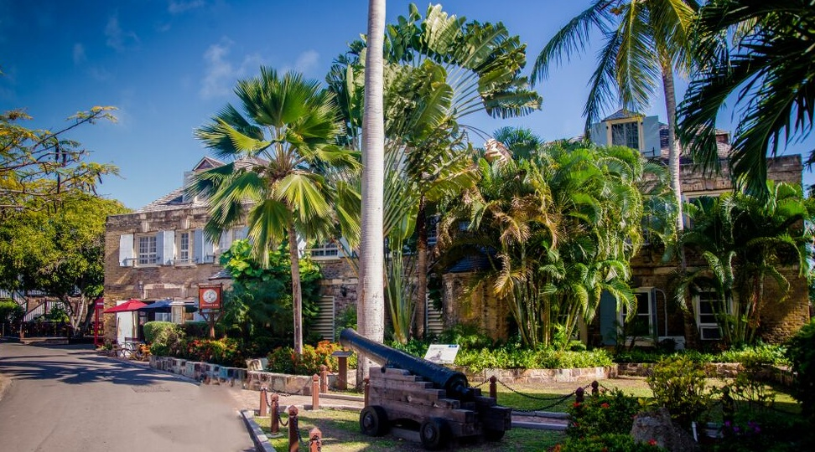
Caribbean Small Hotels - Present
October, 2015 Tegucigalpa, Honduras Presenter: Denise Aleong-Thomas

Slide 13
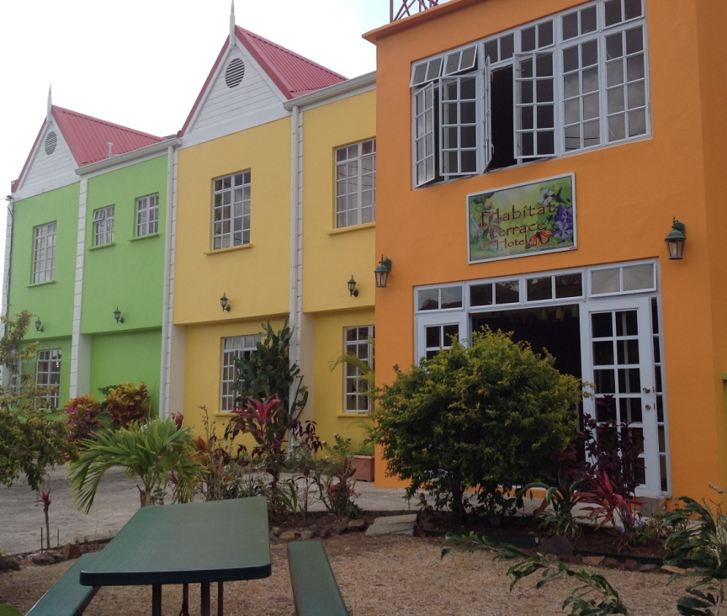
Caribbean Small Hotels - Present
October, 2015 Tegucigalpa, Honduras Presenter: Denise Aleong-Thomas

Slide 14
Caribbean Small Hotels - Present
October, 2015 Tegucigalpa, Honduras Presenter: Denise Aleong-Thomas

Slide 15
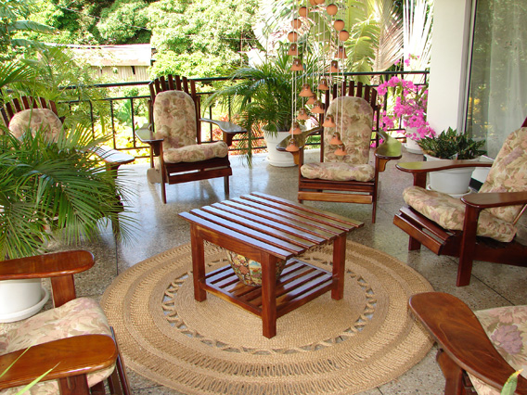
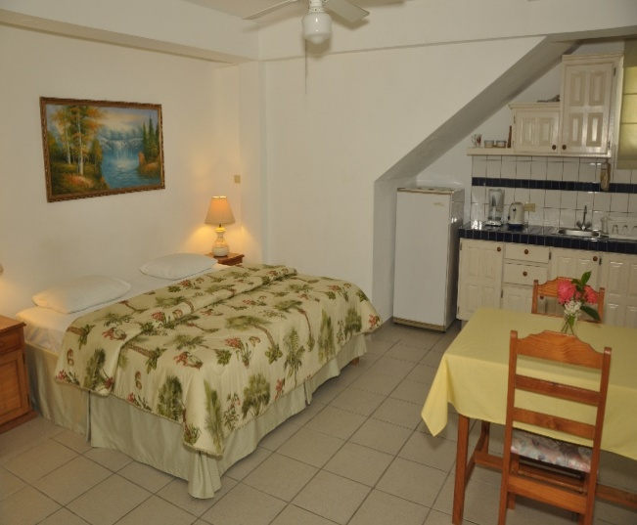
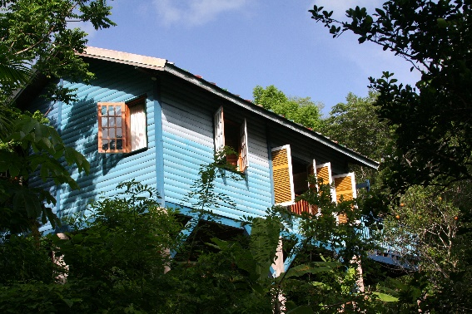
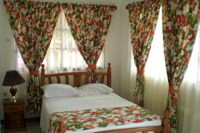
Caribbean Small Hotels - Present
October, 2015 Tegucigalpa, Honduras Presenter: Denise Aleong-Thomas

Slide 16
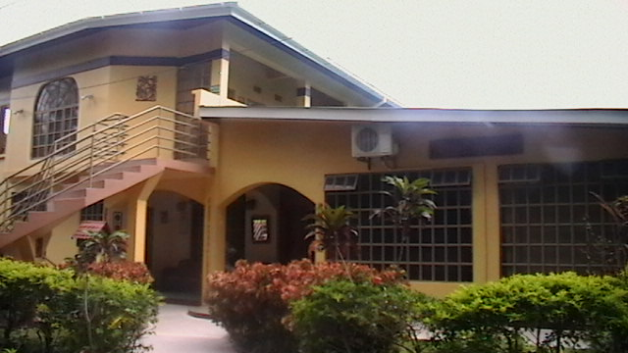
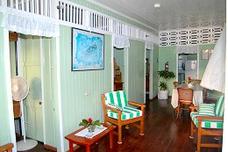
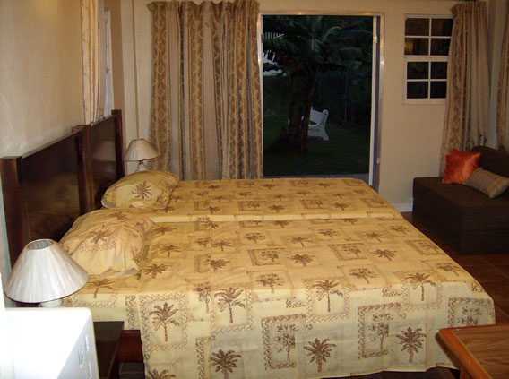
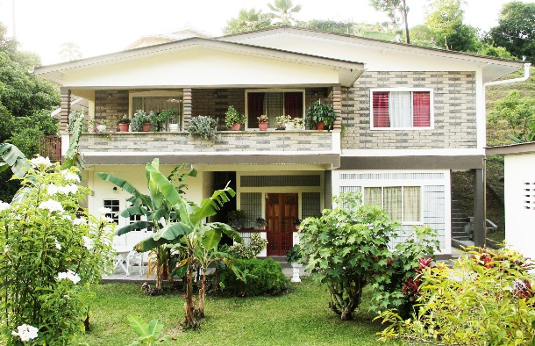
Caribbean Small Hotels - Present
October, 2015 Tegucigalpa, Honduras Presenter: Denise Aleong-Thomas

Slide 17
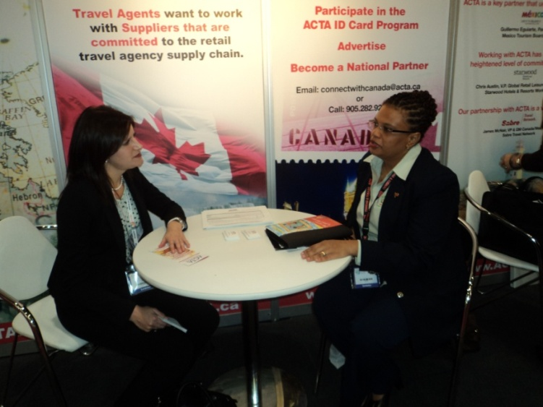
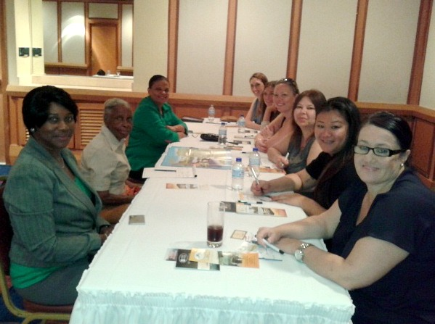
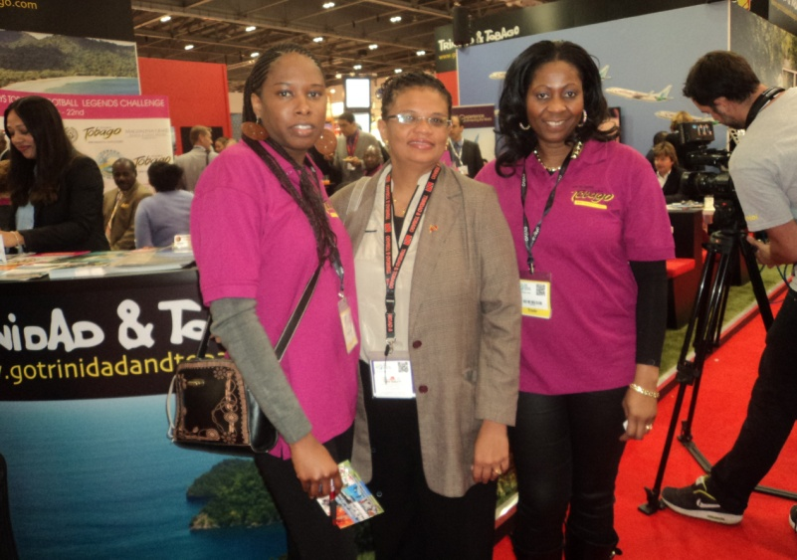
Caribbean Small Hotels - Present
October, 2015 Tegucigalpa, Honduras Presenter: Denise Aleong-Thomas

Slide 18
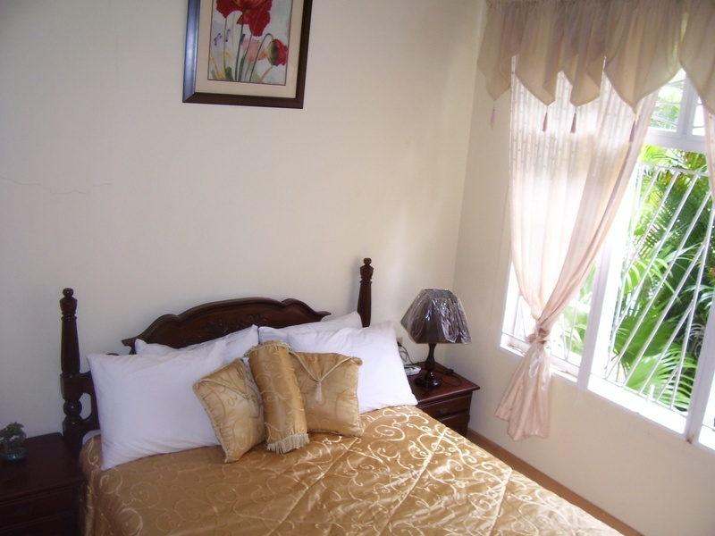
Caribbean Small Hotels - Present
October, 2015 Tegucigalpa, Honduras Presenter: Denise Aleong-Thomas

Slide 19
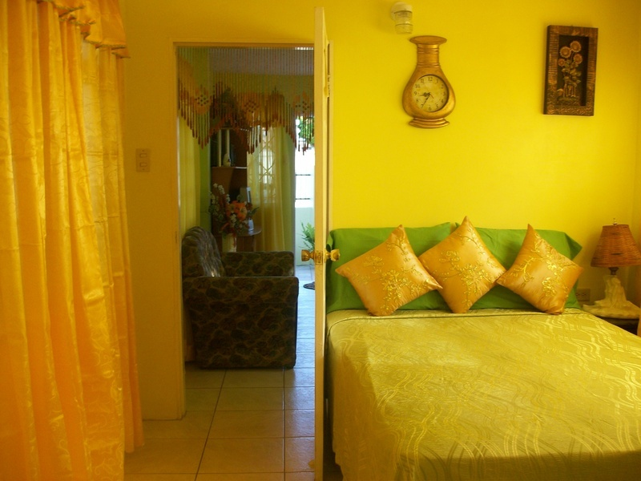
Caribbean Small Hotels - Present
October, 2015 Tegucigalpa, Honduras Presenter: Denise Aleong-Thomas

Slide 20
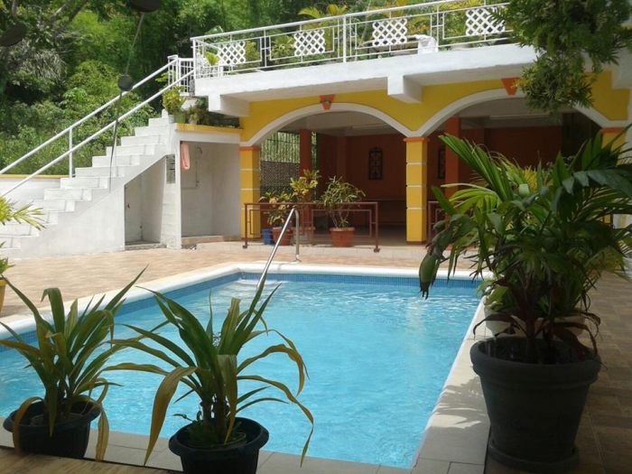
Caribbean Small Hotels - Present
October, 2015 Tegucigalpa, Honduras Presenter: Denise Aleong-Thomas

Slide 21
Caribbean Small Hotels - FUTURE
Opportunities to get involved in Community Tourism and thereby promoting Corporate Social Responsibility.
Exploring new markets within closer reach and access to Destinations. Eg: Latin America.
Mobile, Social Media Marketing & Networking Opportunities
Legislation to regulate Standards and Quality.
New avenues and opportunities for Financing for Small Hotels.
October, 2015 Tegucigalpa, Honduras Presenter: Denise Aleong-Thomas

Slide 22
Tegucigalpa, Honduras Presenter: Denise Aleong-Thomas
THANK YOU!

