Slide 1
Permanent Mission of Saint Vincent and the Grenadines to the Organization of the American States (OAS)​
Regular Meeting of the Permanent Council​
Wednesday 14th April, 2021​
(updated for IACNDR)

Slide 2
The Eruption of La Soufrière​

Slide 3
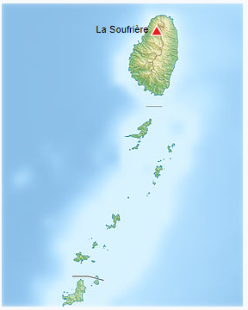
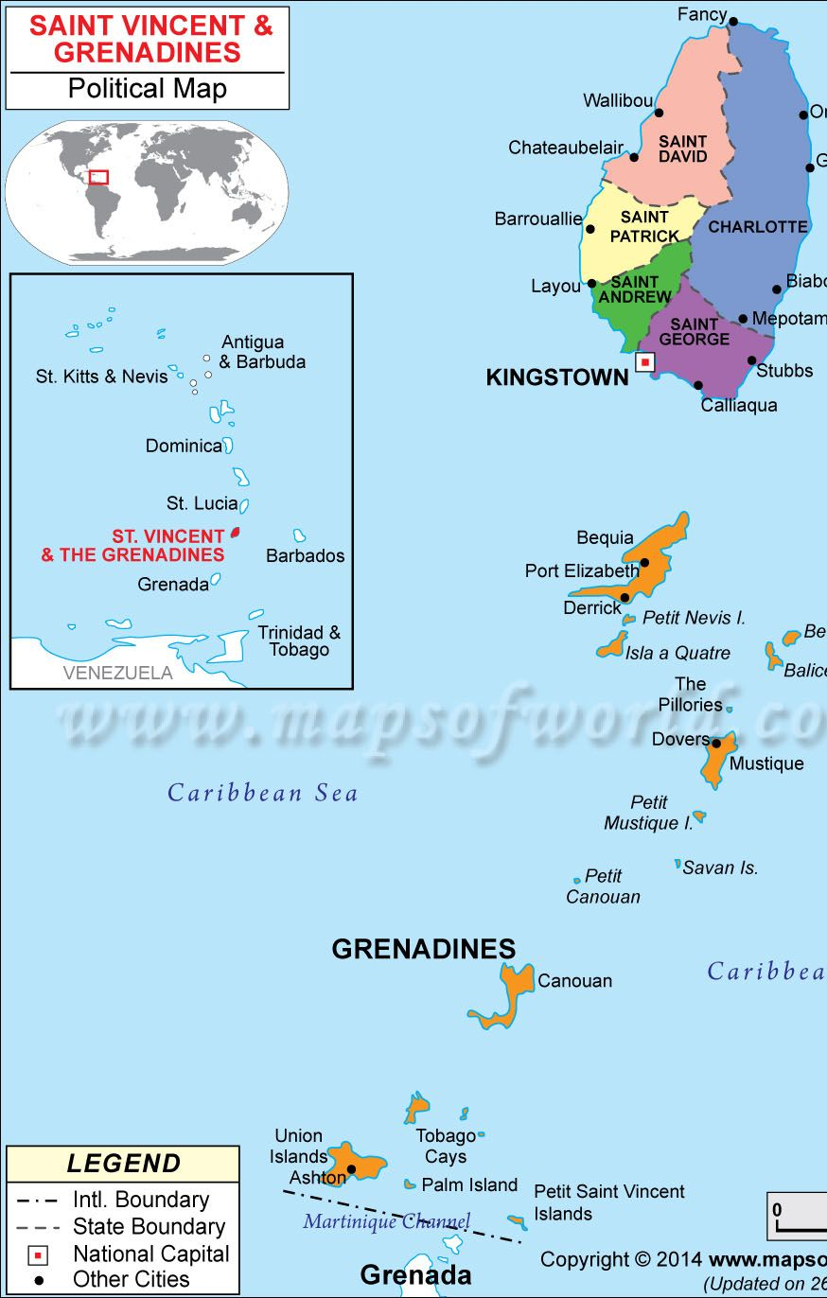
Location of the La Soufrière Volcano in Saint Vincent and the Grenadines (SVG)

Slide 4
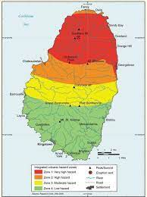
29th December, 2020
Saint Vincent and the Grenadines – Hazard Map
The Government of Saint Vincent and the Grenadines (SVG) and the National Emergency Management Organization (NEMO) informed the nation of increased activity at the La Soufrière volcano.
Further checks revealed an effusive eruption and the creation of a new dome on the western side of the volcano.
An orange alert was issued for the country.
Communities in the red and orange zones were placed on evacuation alert in the event of an explosive eruption.

Slide 5
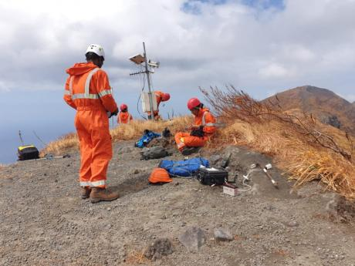
The SVG Volcano Monitoring and Evaluation Team received support from the University of the West Indies Seismic Research Center (UWI-SRC) in Trinidad and Tobago.
The lead scientist, Professor Richard Robertson, indicated that the duration of the effusive eruptions was unclear and was uncertain as to when eruptions would turn explosive.
Additional monitoring equipment was installed and samples were collected from the new dome.

Slide 6
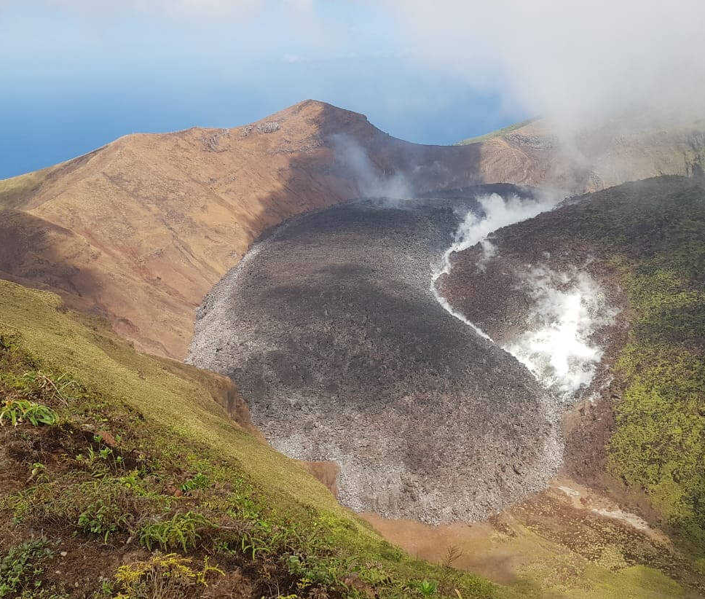
23rd March, 2021
Changes in volcanic activity reported by the scientists
Low frequency events and volcano-tectonic earthquakes; the largest measuring a magnitude of 2.6.
These were felt by communities near the volcano.

Slide 7
8th April, 2021
1:00 p.m.
Press conference by the Prime Minister to update citizens on information received from scientists.
Further increase in volcanic activity signaling an imminent explosive eruption within hours or 2 days.
An evacuation declaration was issued signaling stage 3, and residents in the red and orange zones were notified to prepare to evacuate.
4:30 p.m.
Another press conference by the Prime Minister indicated a deterioration of conditions at the volcano.
An immediate evacuation order of all communities in the red zone and some communities in the orange zone on the western side of the island.
The emergency alert was moved to red - signaling a stage 4 disaster.
Emergency shelters were activated.

Slide 8
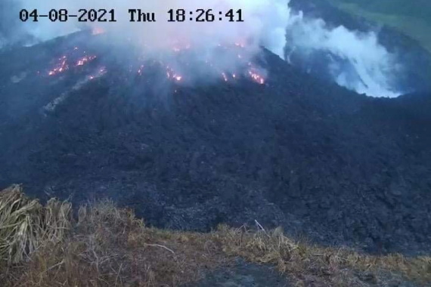
9th April,2021
Approximately 8:40 a.m. on Friday 9th April, 2021, explosive eruptions started at the La Soufrière volcano and have continued.
Evacuation continued, and was conducted by the Police, the Red Cross and the National Emergency Management Organization ( NEMO), and private citizens assisted with their motor vehicles and boats.
Some evacuees went to shelters, hotels and guest houses provided by the government. Others stayed with family and friends or rented private accommodation.

Slide 9
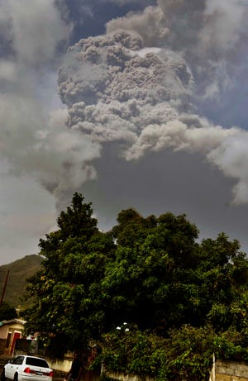
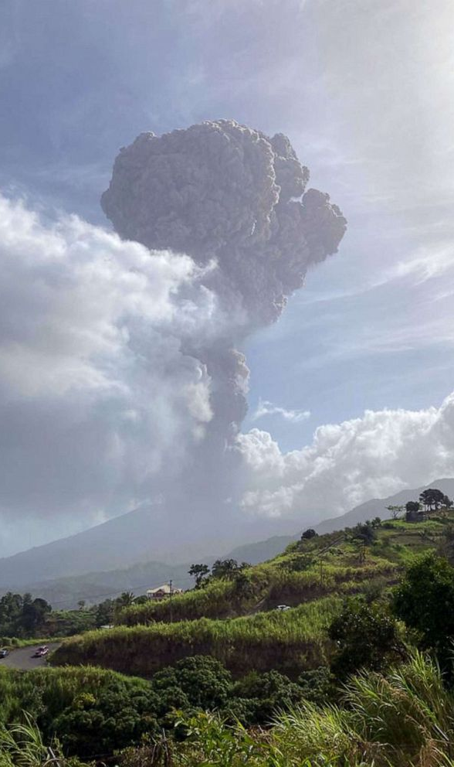

Slide 10
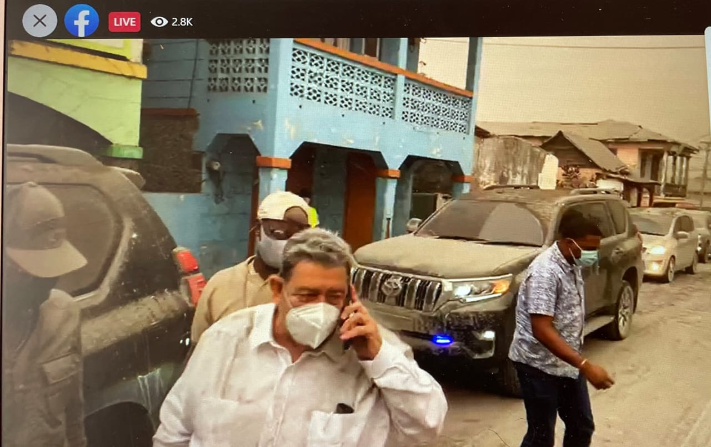
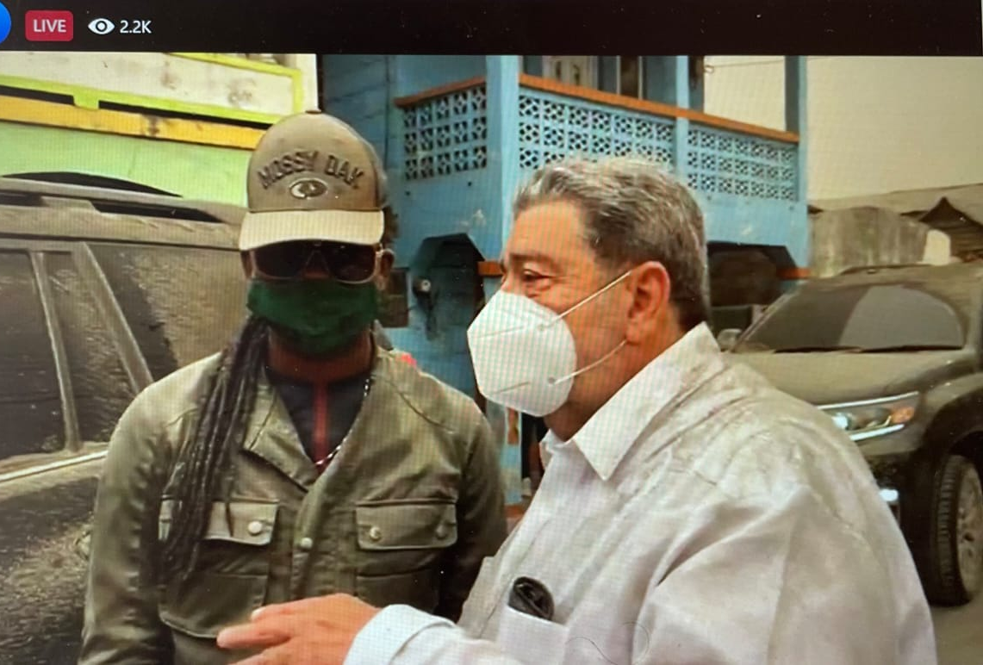
Prime Minister Dr. The Hon. Ralph E Gonsalves visiting affected areas in the red zone

Slide 11
The Current Situation
89 shelters with over 4,100 occupants, ranging from new-borns to the elderly
Several eruptions since 9th April - the largest occurring on 12th April
12th April eruption – both domes collapsed, and pyroclastic flows recorded
Copious amounts of ash blanketed the entire island
Neighbouring islands affected by ashfall: Barbados, St. Lucia and Grenada and it is likely to affect other islands
Airport closure in SVG and Barbados
Scientists informed that this eruption is reminiscent of the deadly 1902 volcanic eruption
1,333 –displaced families 3,275 – displaced people in private shelters
7,411 total number of registered displaced persons
Zero Casualties

Slide 12
The Current Situation – COVID 19
April 9th, 2021 April 14th, 2021
One (1) reported case Six (6) reported cases
Total cases 1,790 (March Total cases 1,818 (March 2020-
2020 – April 2021) April 2021)
Sixteen (16) recoveries Zero (0) recoveries
One hundred and twenty-nine One hundred and thirty-one active
(129) active cases (131) cases
Ten (10) total deaths Ten (10) total deaths

Slide 13
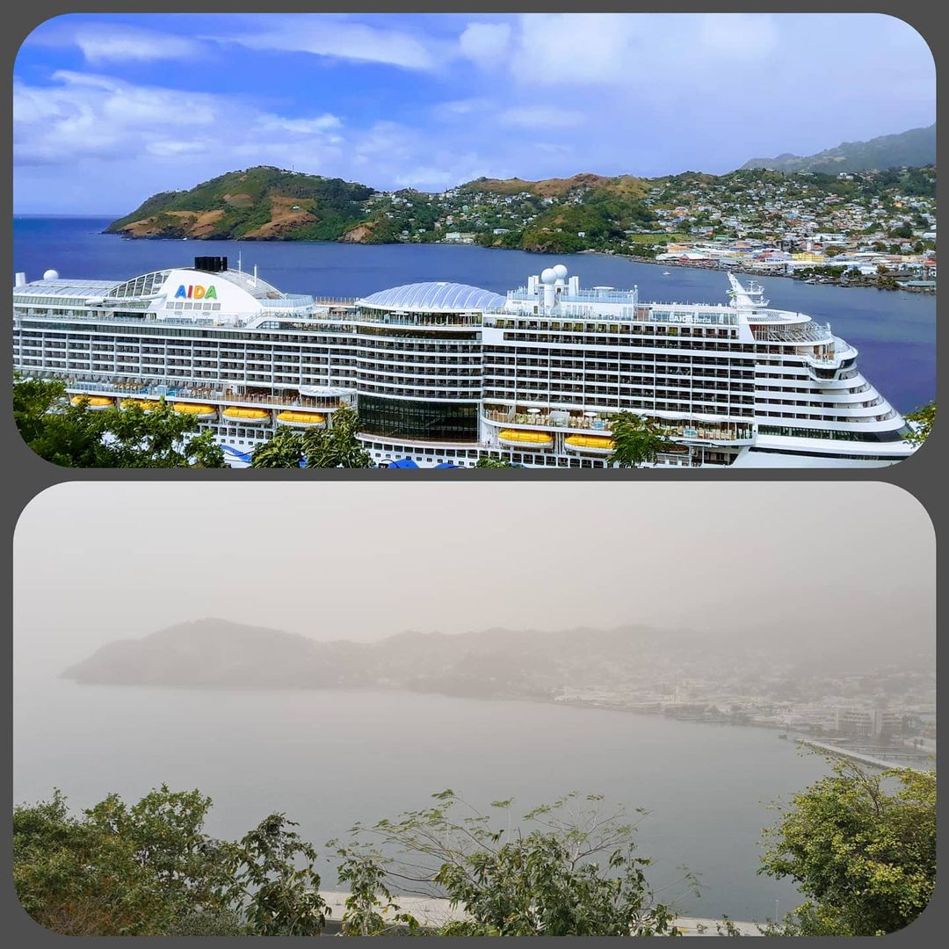

Slide 14
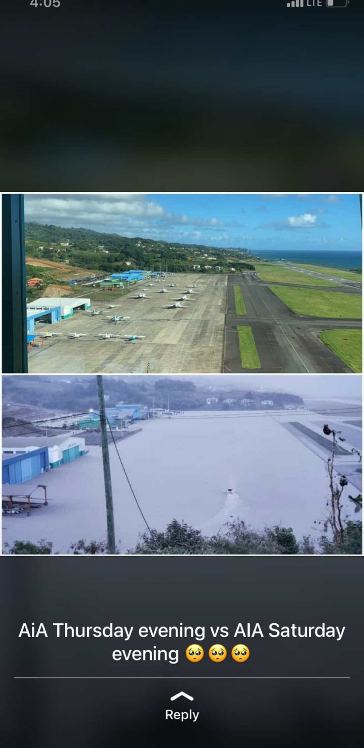

Slide 15
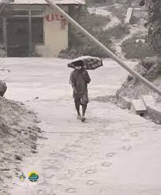
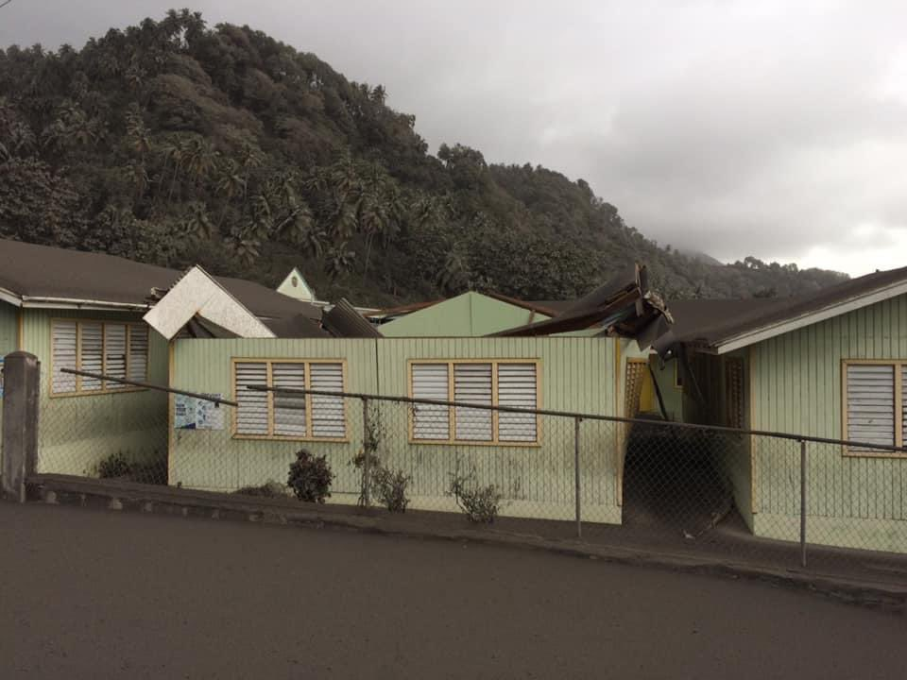

Slide 16
Ash cover in Barbados

Slide 17
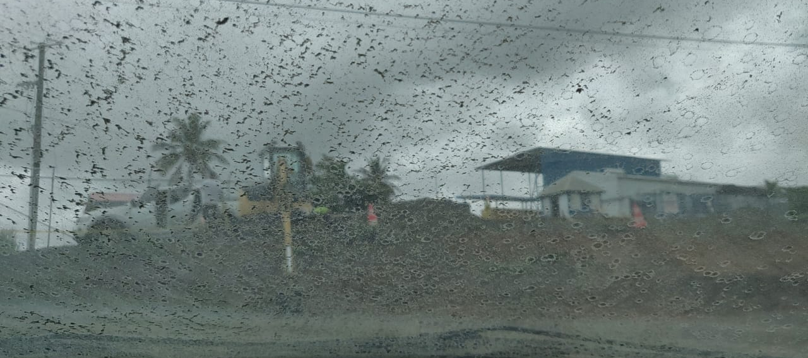
Ash cover in St. Lucia

Slide 18
Disruptions to the Electricity and Water Supply
Unstable electricity due to ashfall on electrical pole wires.
Water flow interruption.
The Central Water and Sewerage Authority (CWSA) is tapping into underground supplies from wells and springs.
Water sources contaminated by ash.
Water being supplied now via trucks.
Pipelines have also been affected.

Slide 19
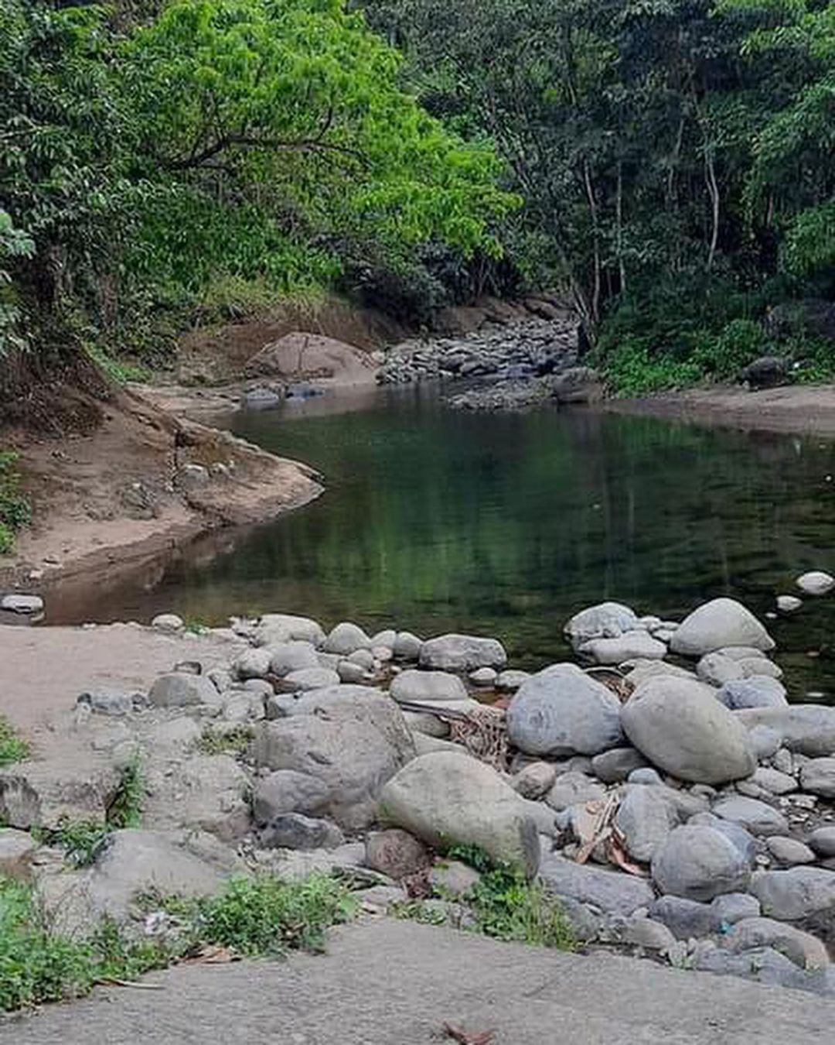

Slide 21
Regional and International Support
CARICOM – Countries, Institutions, and private citizens have pledged support in housing evacuees, and in providing supplies, assistance and funds.
Vincentian and Caribbean Diaspora have been mobilized.
Royal Caribbean and Carnival cruise lines – employers of thousands of Vincentians to provide temporary accommodation on ships.
U.K, U.S, UN, World Bank, Canada, Cuba, DR, ROC (Taiwan), Venezuela, and PAHO/WHO offered or provided different types of assistance.
SVG needs and would appreciate support and assistance from fellow OAS Member States, Permanent Observers, Institutions, NGOs, Foundations, Charities, Individuals, and other partners, now and as the country rehabilitates its resources , lives and livelihoods.

Slide 22
Support for Relief Efforts
Banking information:
Corresponding Banks:
1. Bank of America - SWIFT Code: BOFAUS3M
2. Bank of New York - SWIFT Code: IRVTUS3N
Name: Government of St. Vincent and the Grenadines -Accountant General - Disaster Relief Fund
Bank: Bank of St. Vincent and the Grenadines
Address: Bedford Street, Kingstown, St. Vincent and the Grenadines
Account Number: 137741
Swift Code: NCBVVC22
Donation of items:
SVG DRIP Donations Wish List
https://www.amazon.com/hz/wishlist/ls/19I4BQNACQAQN?ref_=wl_share

Slide 23
Needs List
Water Tanks, Drinking and Domestic Hygiene Water, Water Bladders Collapsible, Water Pumps
Buckets
Folding Cots
Portable Potties (Toilets)
Blankets
Field Tents
Field Kitchens
Sleeping Mats
Respirator masks with filters
Reflective Vests
Caution Tape (100ft roll)
Hygiene Kits
Disinfectants, Bleach, and Liquid soap
Food items (for impacted population 20,000)
Mattresses
Disposable Food Containers or Plastic (reusable)
Generators
Baby supplies

Slide 24
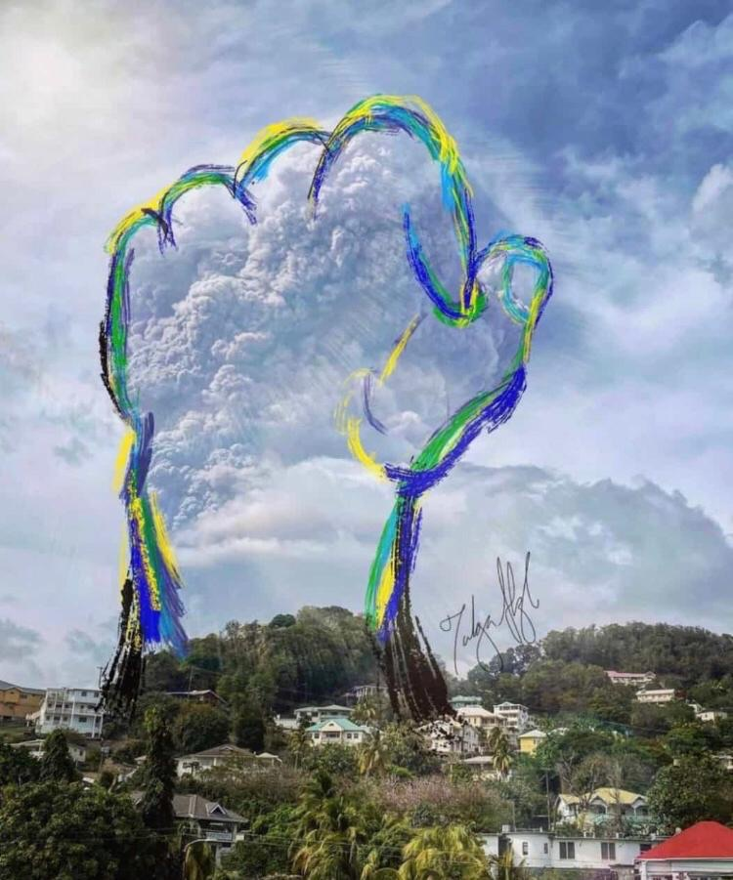
Thank You!!

